Slide 1
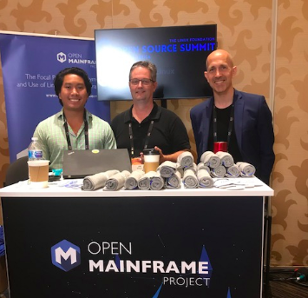
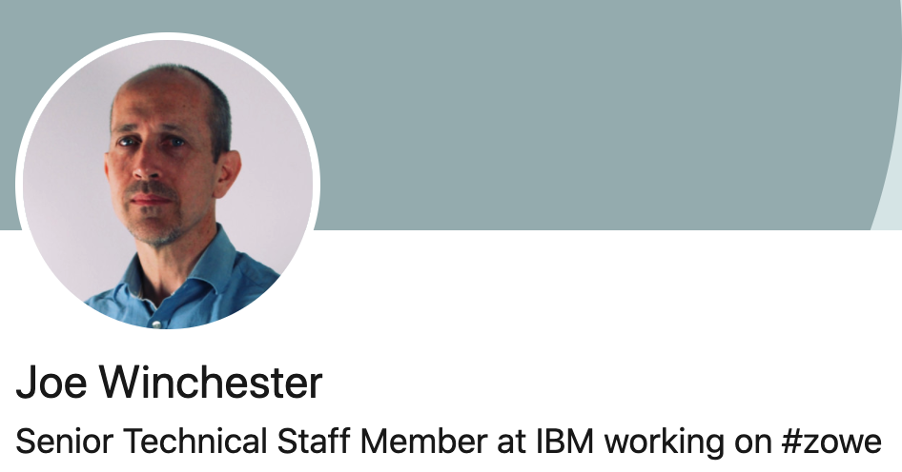

(Virtual) Open Mainframe Project Meetup – Japan
https://www.linkedin.com/in/joewinchester/
https://twitter.com/JoeWinchester

Slide 2

Open
Simple
Familiar
Notes:
Its goal is to provide a platform for access to the mainframe using tools that are
<click to animate text>
Open
Simple
Familiar
<click to introduce red border around zowe.org graphic>
Information about Zowe can be found at zowe.org

Slide 3

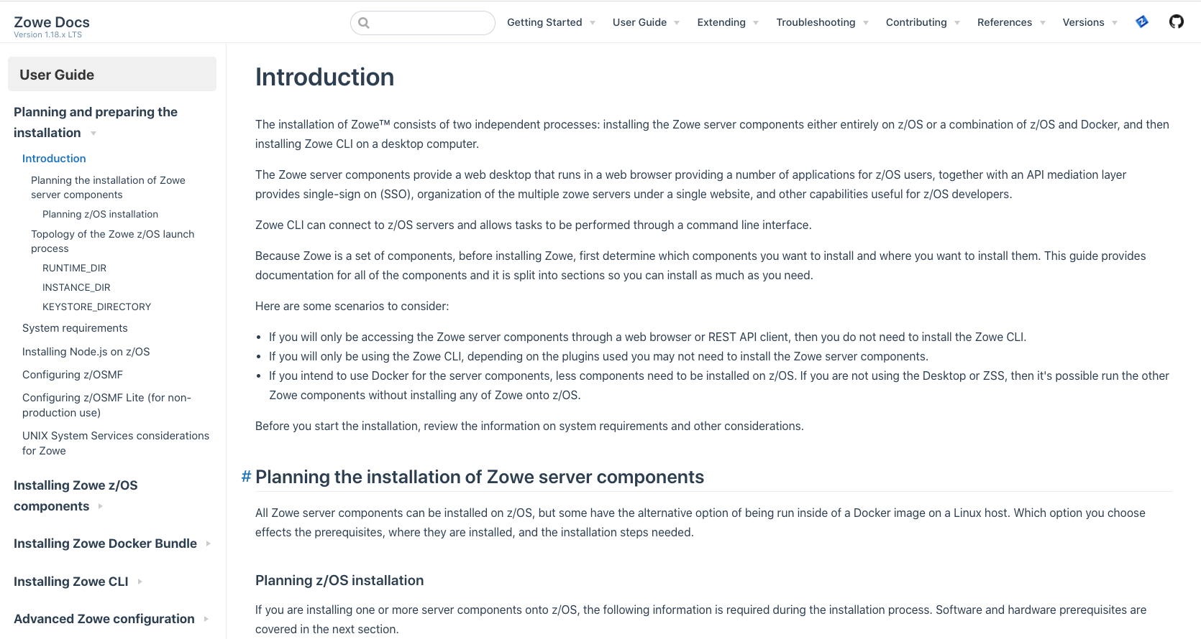
Notes:
documentation

Slide 4

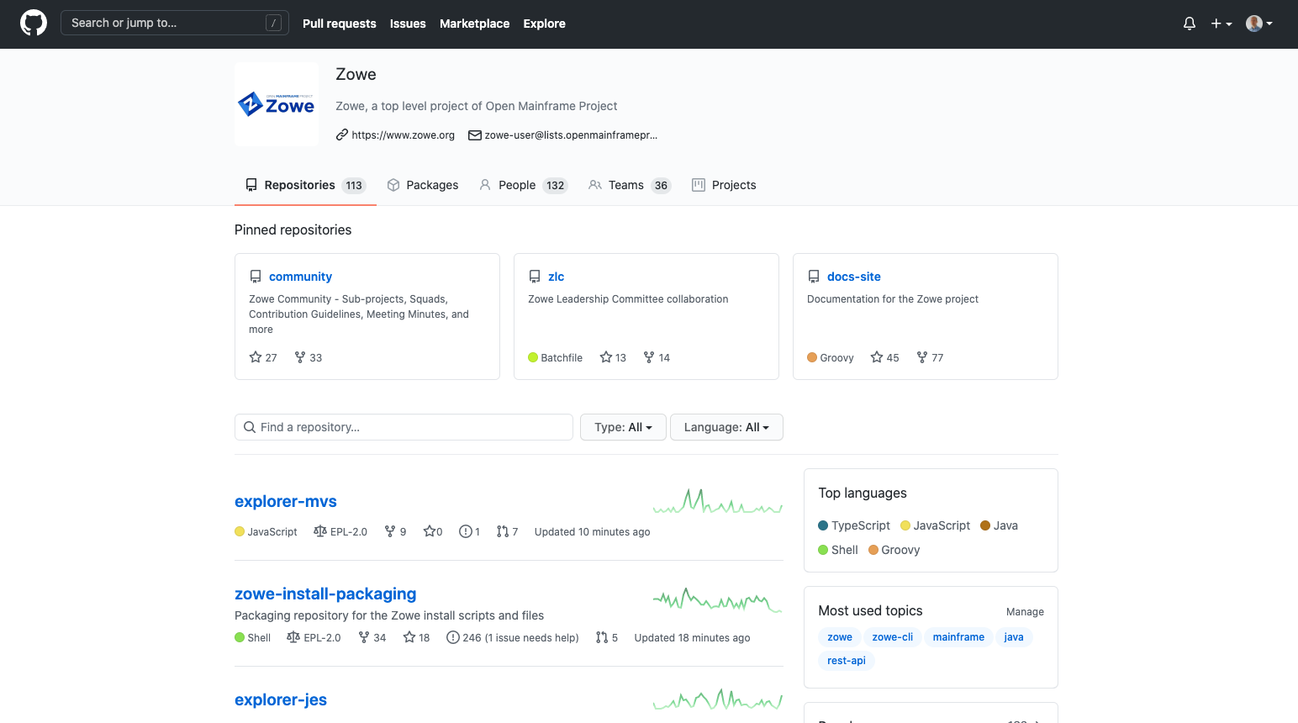
Notes:
As well as github repositories where all of Zowe’s open source code is developed and maintained by its community of committers

Slide 5
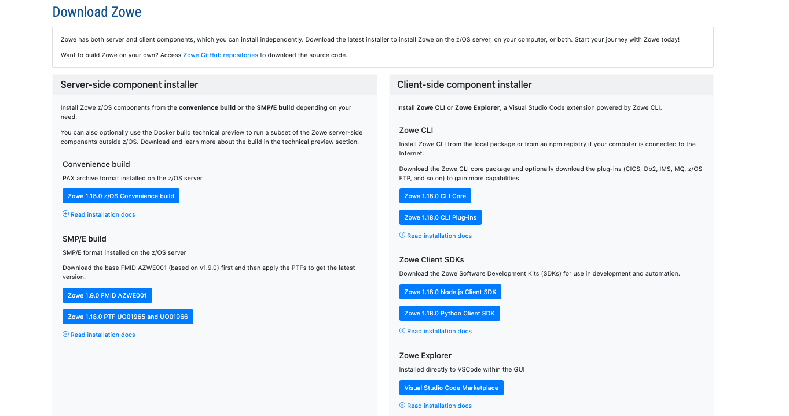
Notes:
Including links to downloads

Slide 6
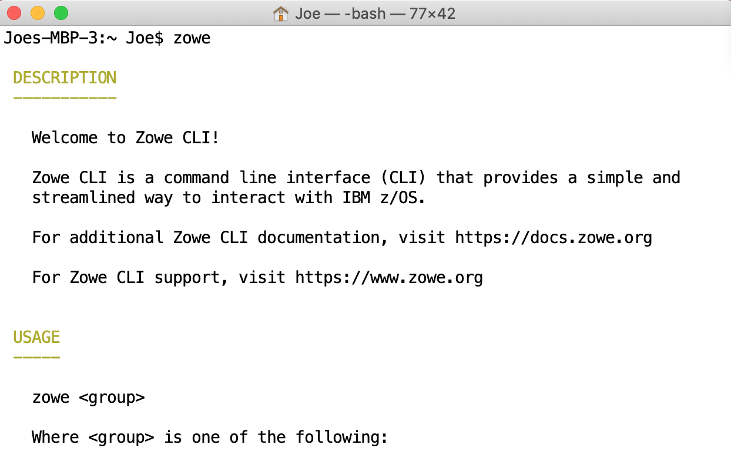
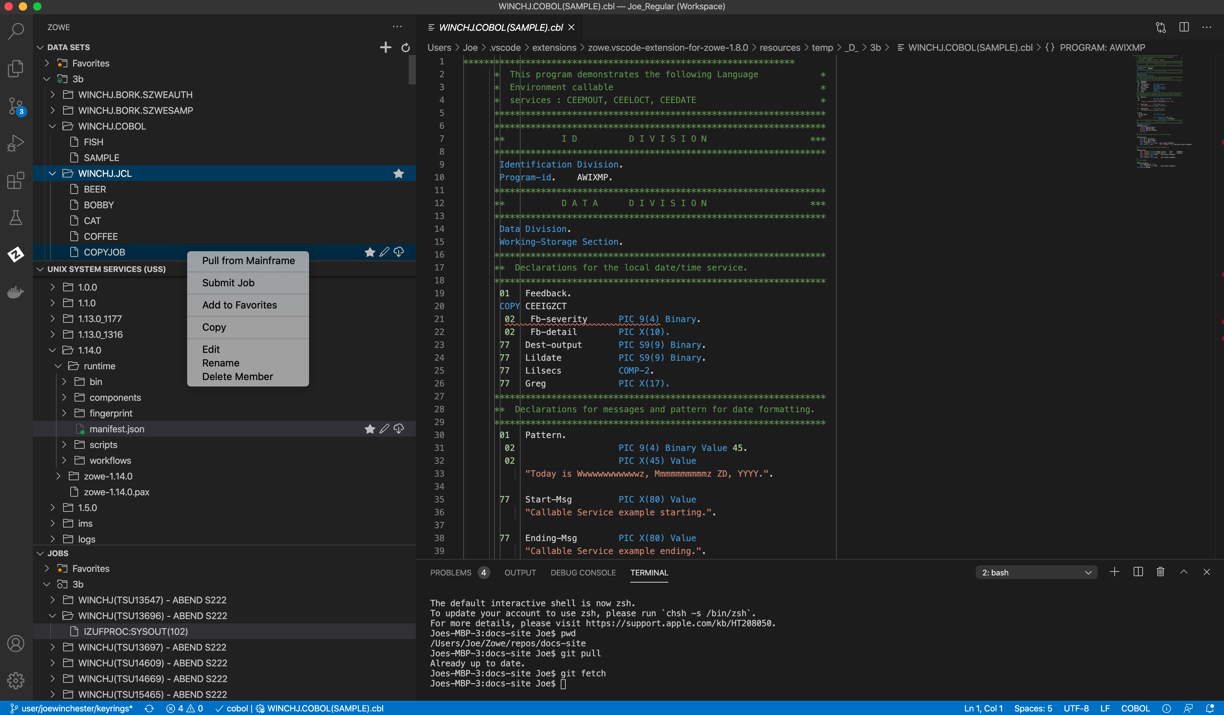
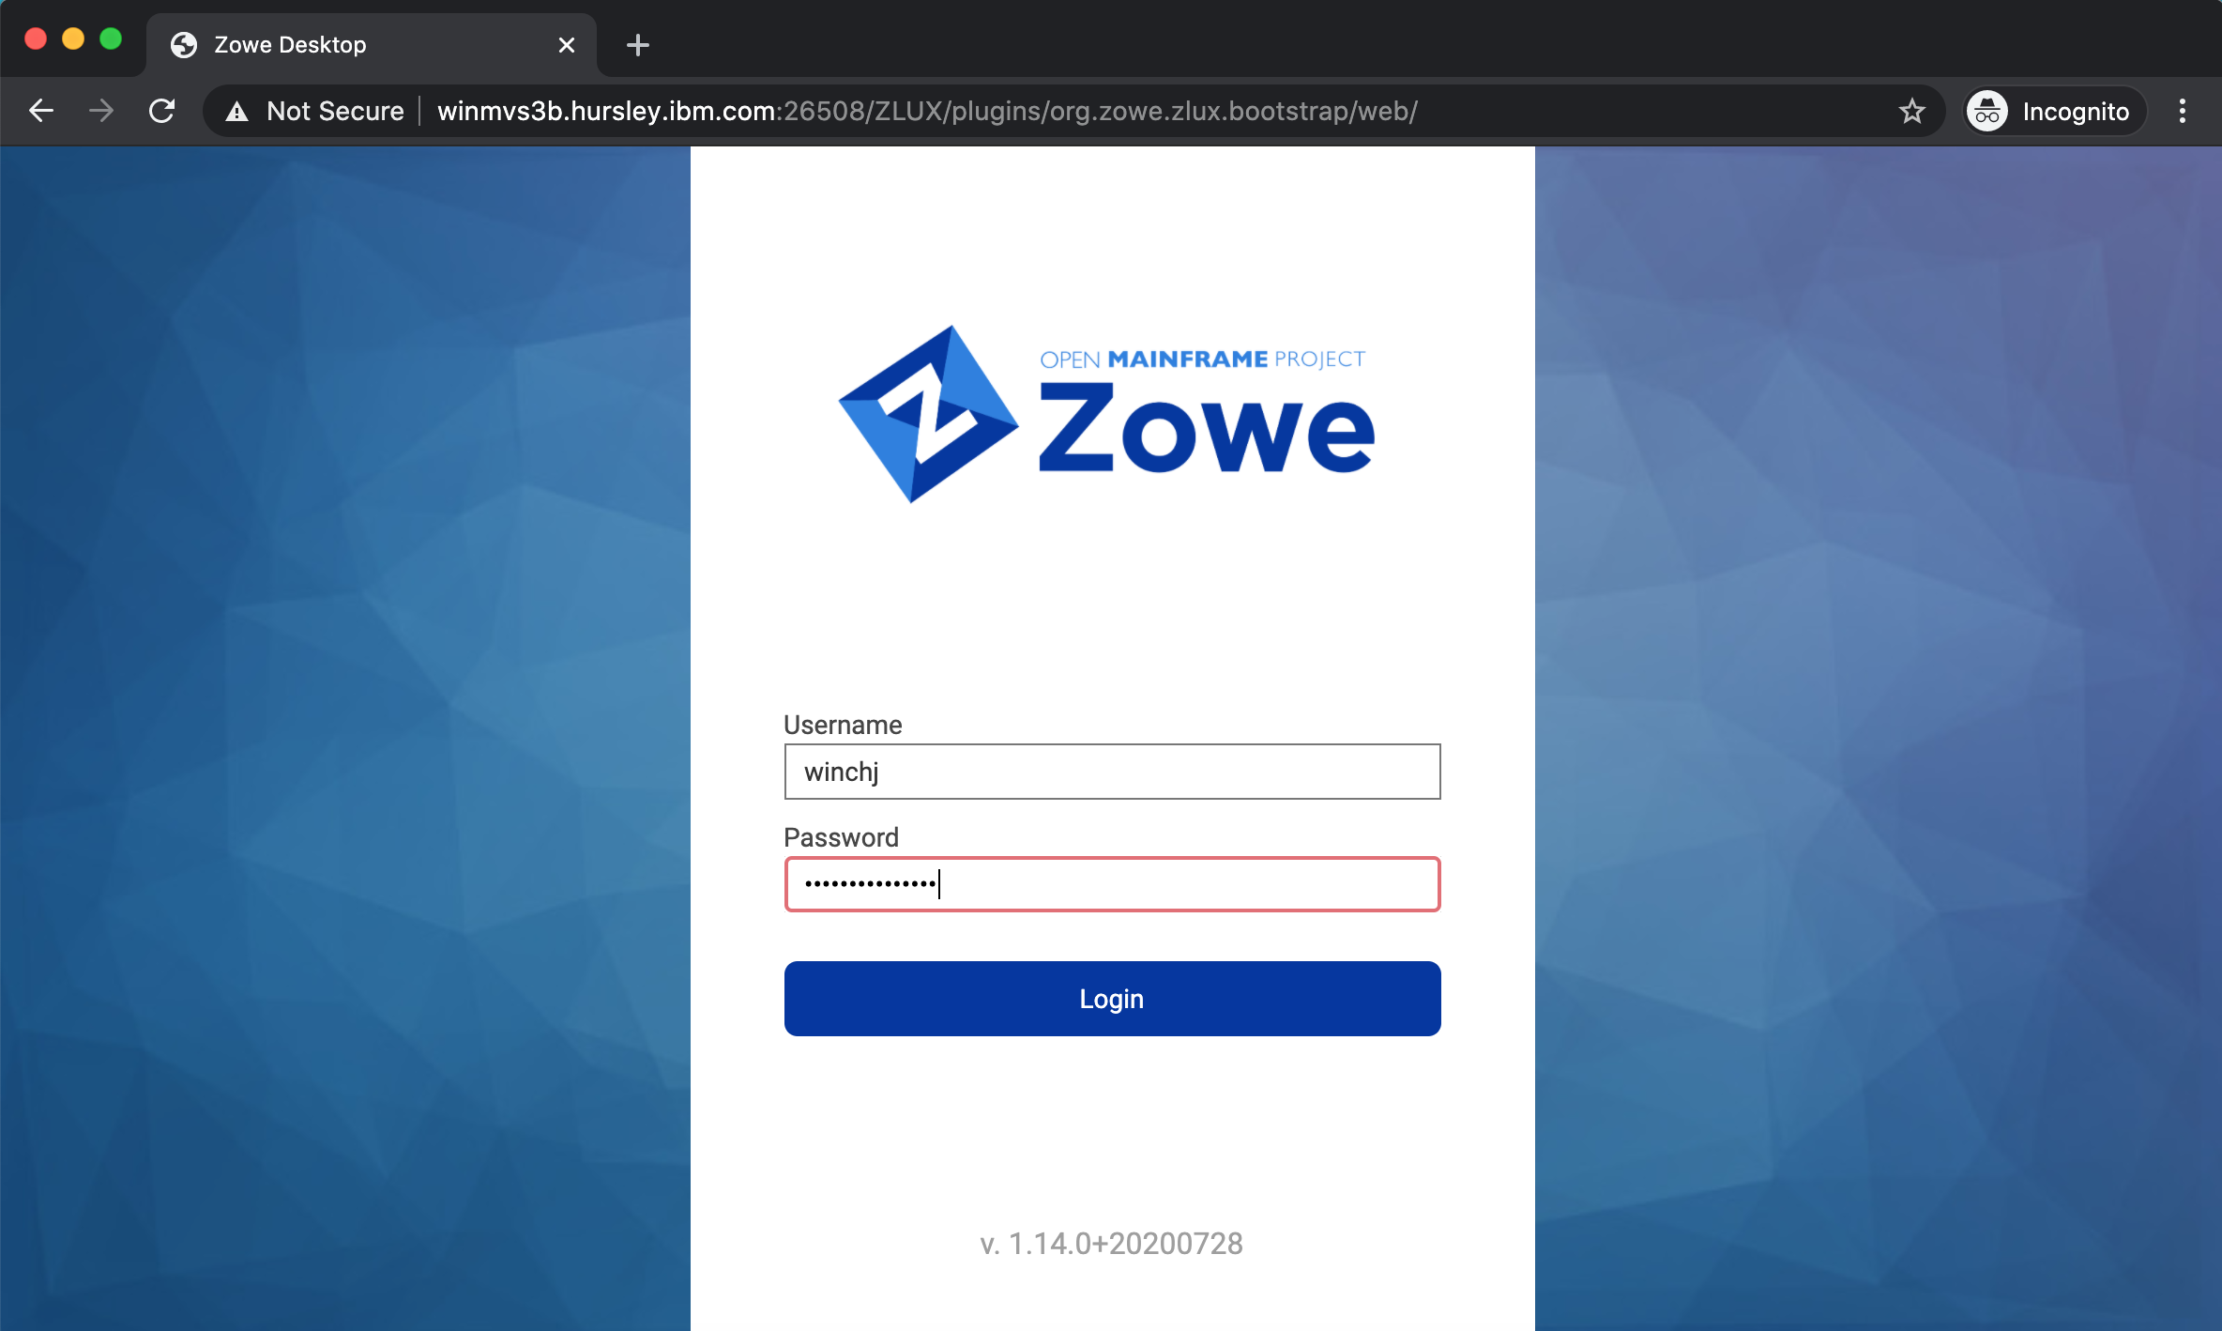
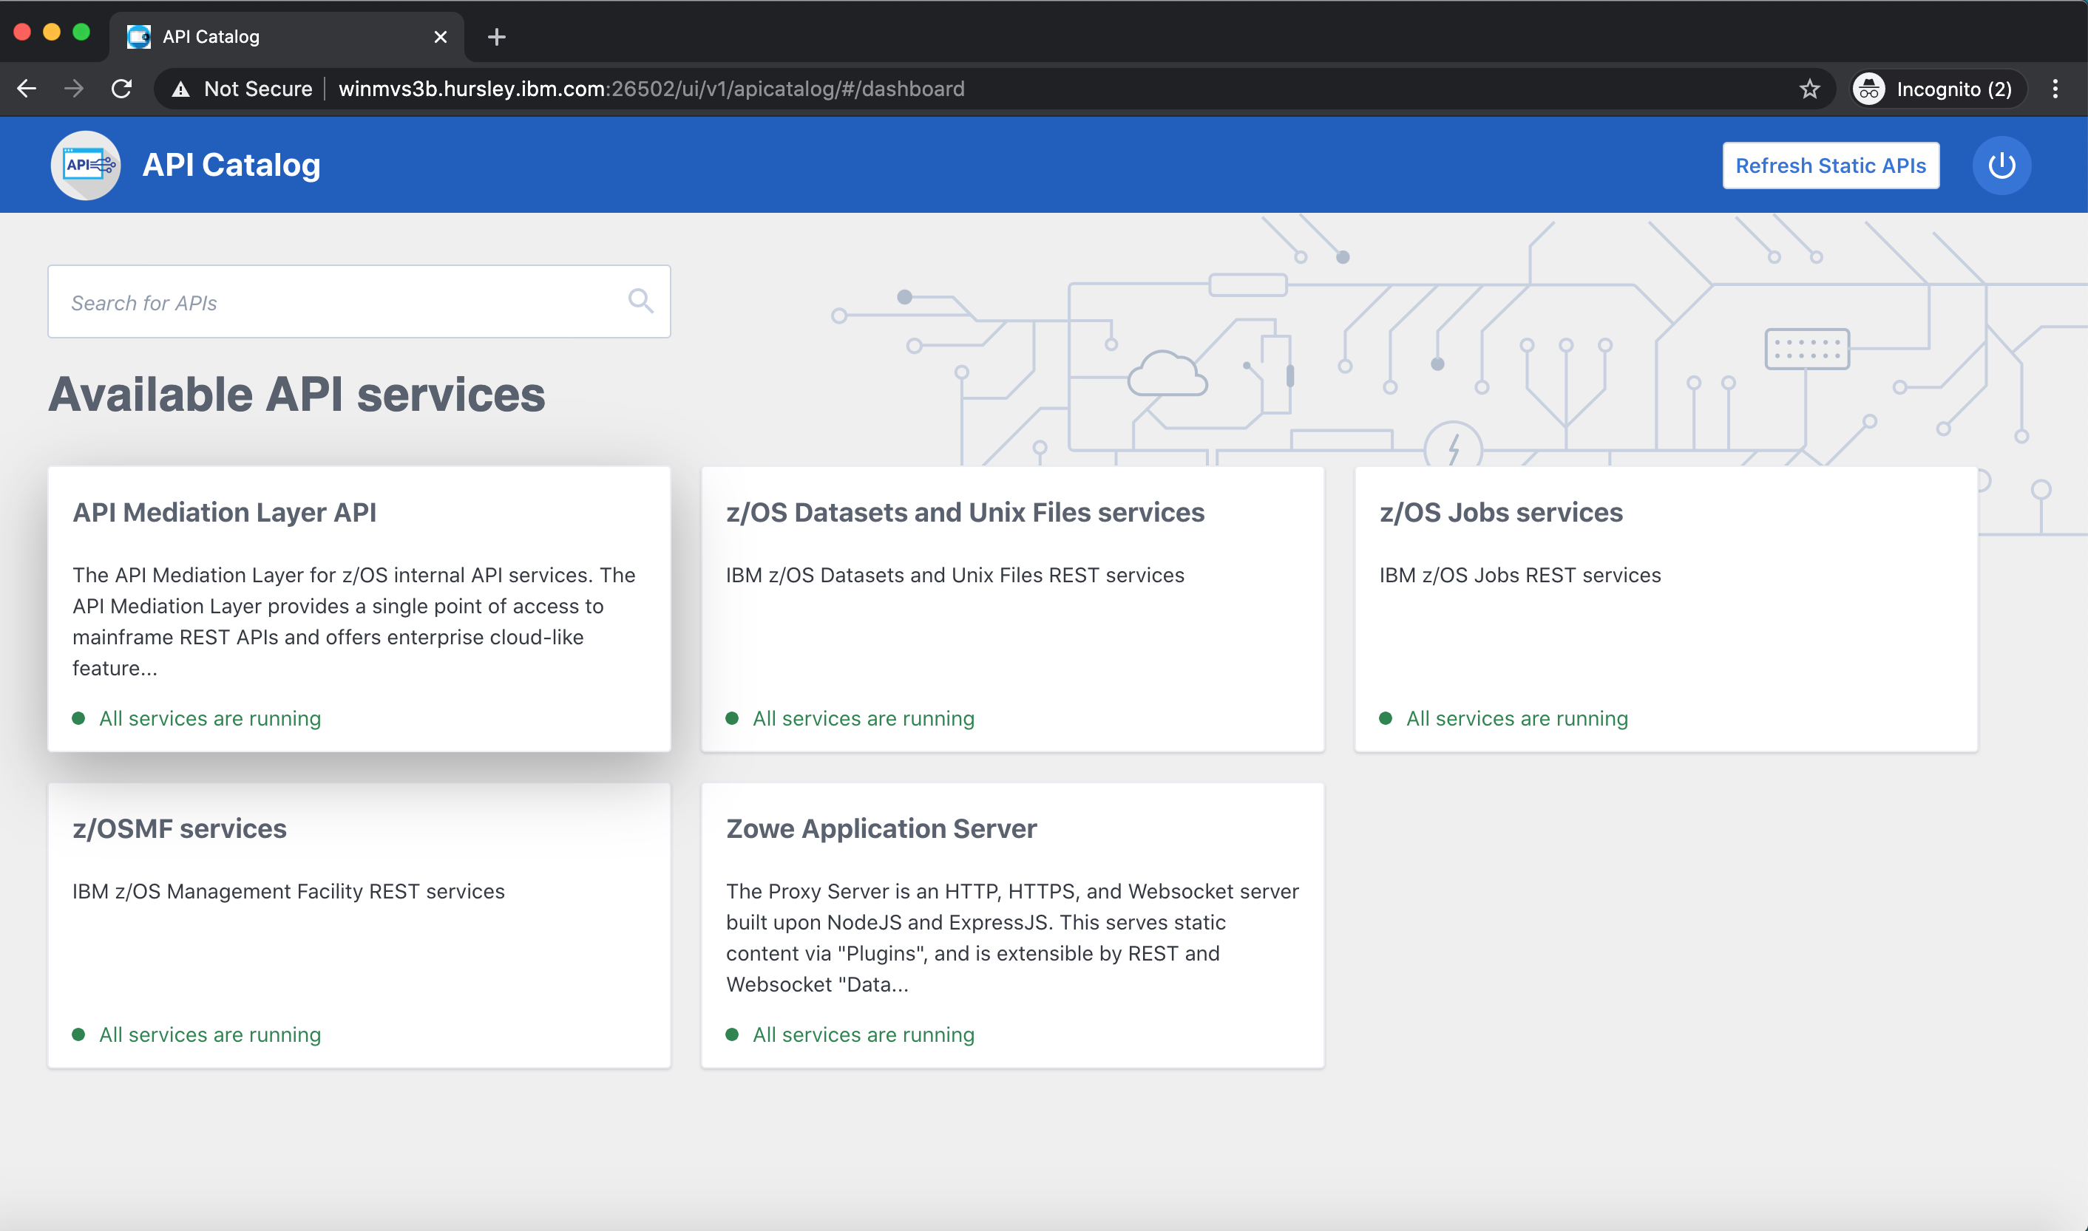
Notes:
Zowe is composed of four main components
<click>
A command line interface
<click>
A visual studio code extension known as the Zowe Explorer
<click>
A web user interface accessible through a desktop browser
<click>
And a powerful API Mediation Layer
Let’s look at each of these in more detail.

Slide 7
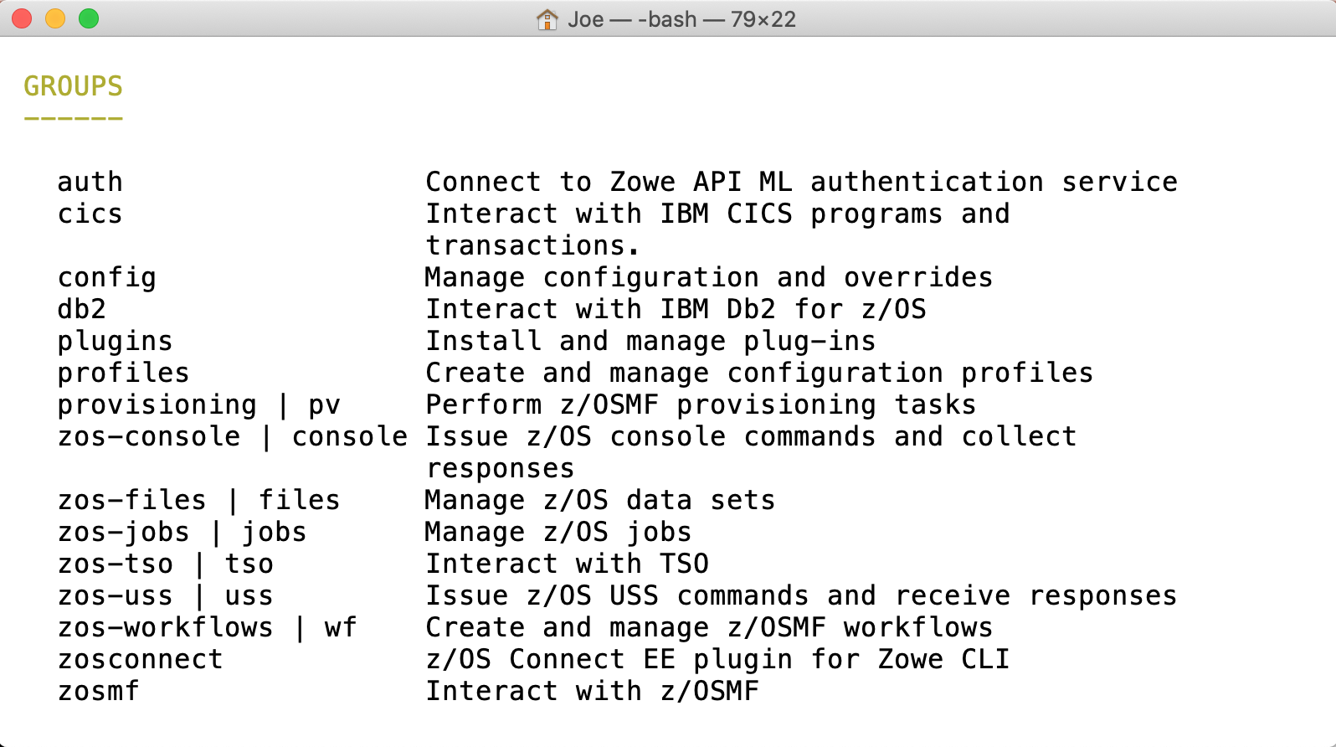
Command Line Interface
Notes:
The command user interface, or CLI, allows a user to issue commands from their PC to directly operate and manage their mainframe.
<click>
CLI commands are broken down into groups. The core set includes groups to work with
<click>

Slide 8
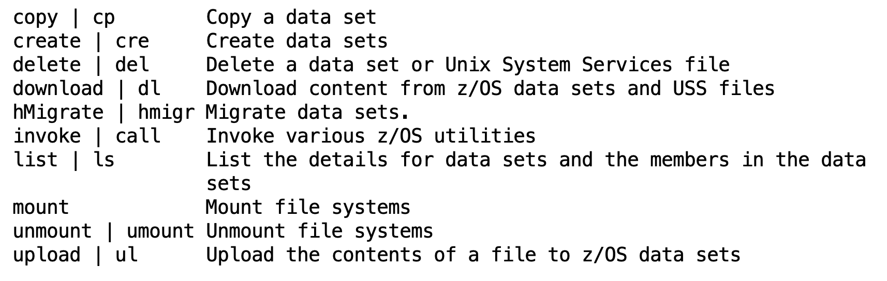

Slide 9
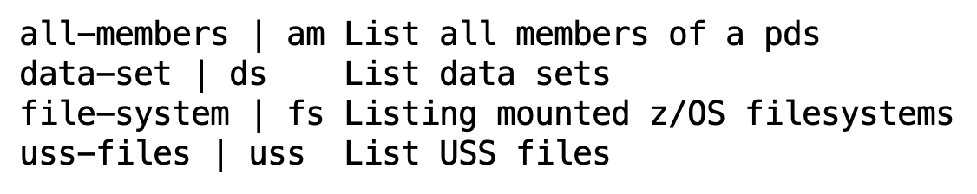

Slide 10
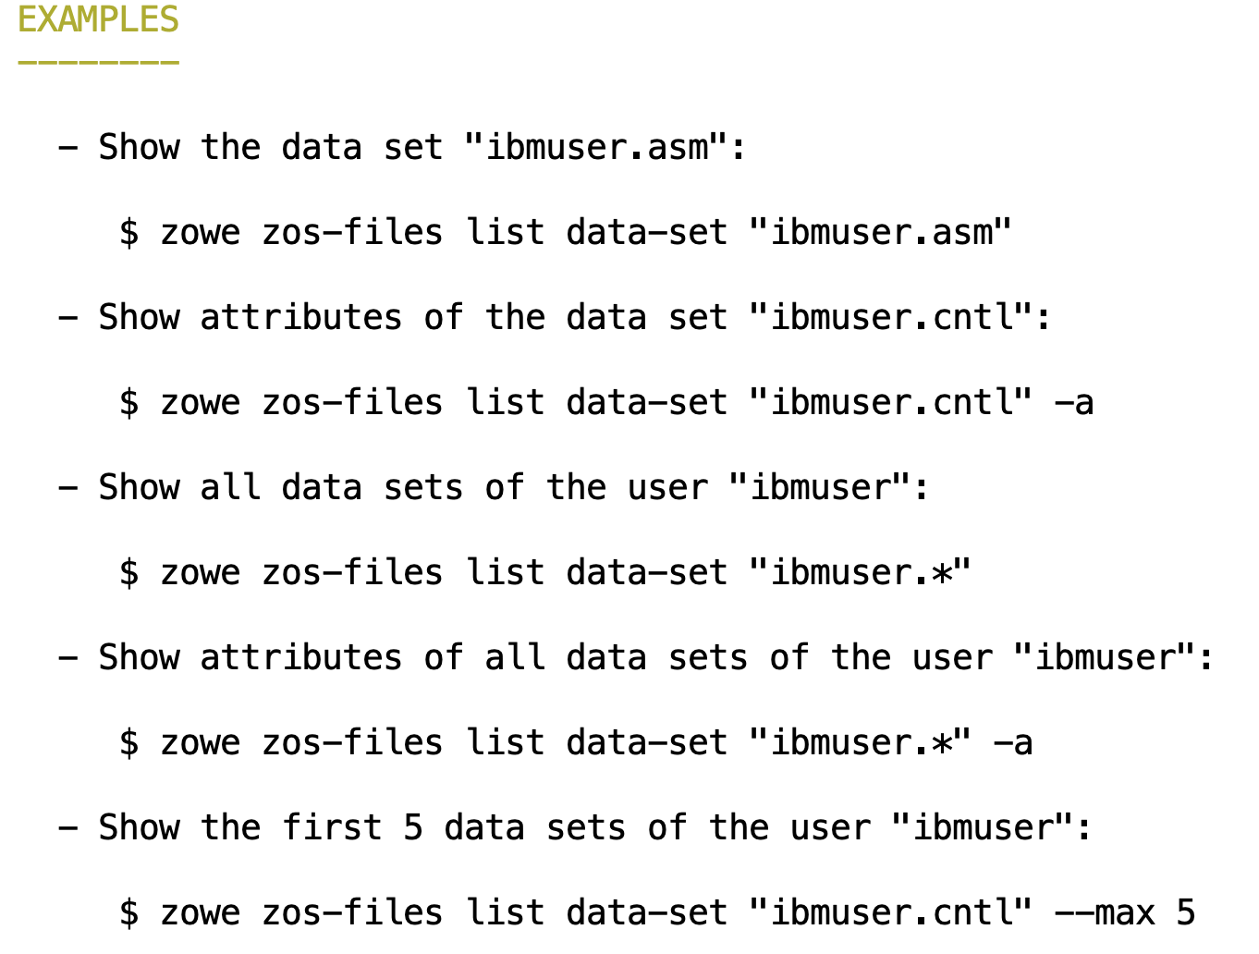

Slide 11
joes-mbp-3:builds Joe$ zowe files list ds "WINCHJ.*"
WINCHJ.JCL
WINCHJ.JCL.DEMO
WINCHJ.PARMLIB
WINCHJ.SPF.ISPPROF
WINCHJ.SPFLOG2.LIST
WINCHJ.SPFTEMP0.CNTL
WINCHJ.SPFTEMP1.CNTL
WINCHJ.SRCHDSL.LIST
WINCHJ.TEST.X123
WINCHJ.USER.LOG
WINCHJ.XXX.SZWEAUTH
WINCHJ.XXX.SZWESAMP
WINCHJ.ZOWE
WINCHJ.ZOWELIB
WINCHJ.ZOWE1

Slide 12
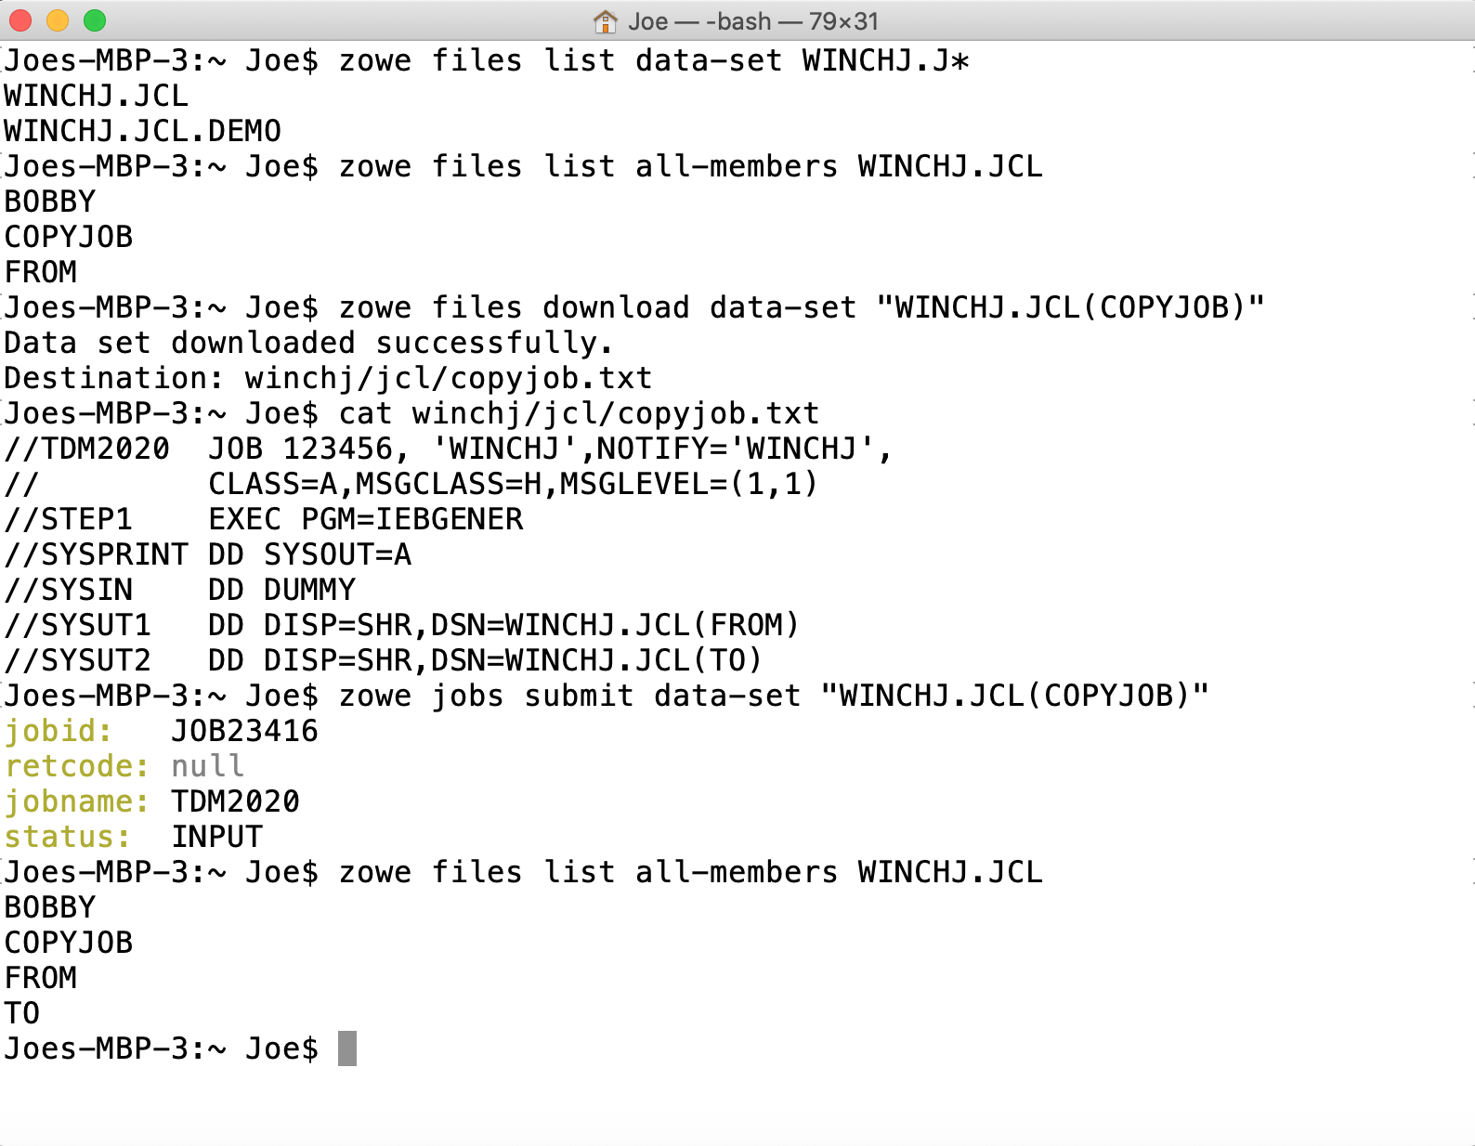
Data sets
Notes:
Data sets, where you can
<click>
list data sets for a file
<click>
List the members of a PDS
<click>
download members to your PC
<clicl>
And submit job control language data sets to the JES queue

Slide 13
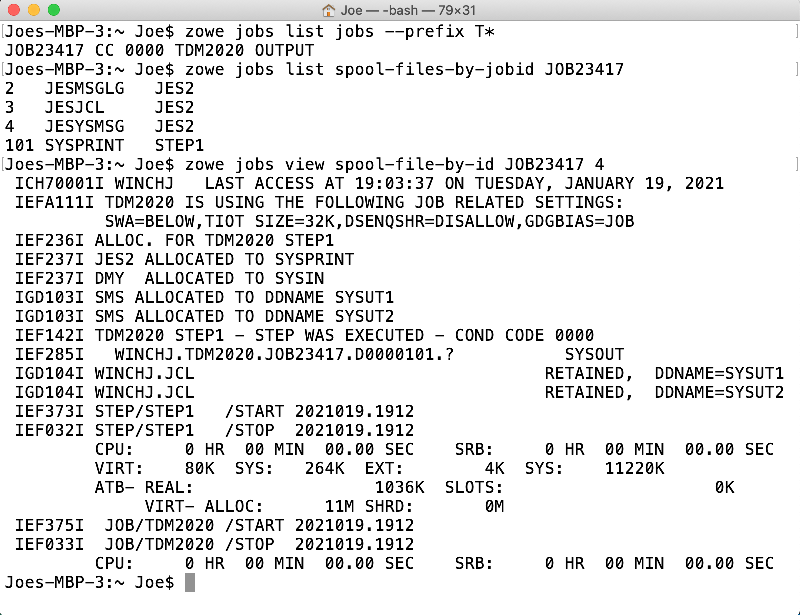
Jobs
Notes:
The jobs groups allows you to
<click>
List jobs by prefix, owner or status
<click>
View a list of spool files
<view>
As well as content for an individual spool file
<click>

Slide 14
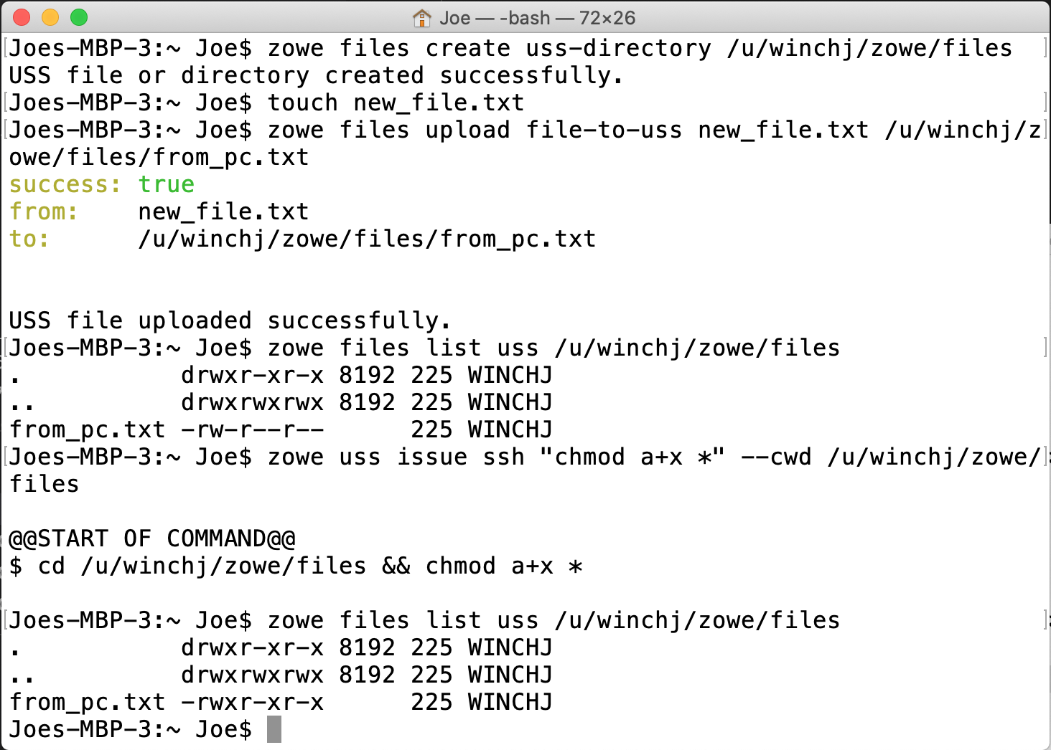
USS
Notes:
With the unix system services group you can
<click>
Create directories
<click>
Upload files from your PC
<click>
As well as issue unix commands directly within USS

Slide 15
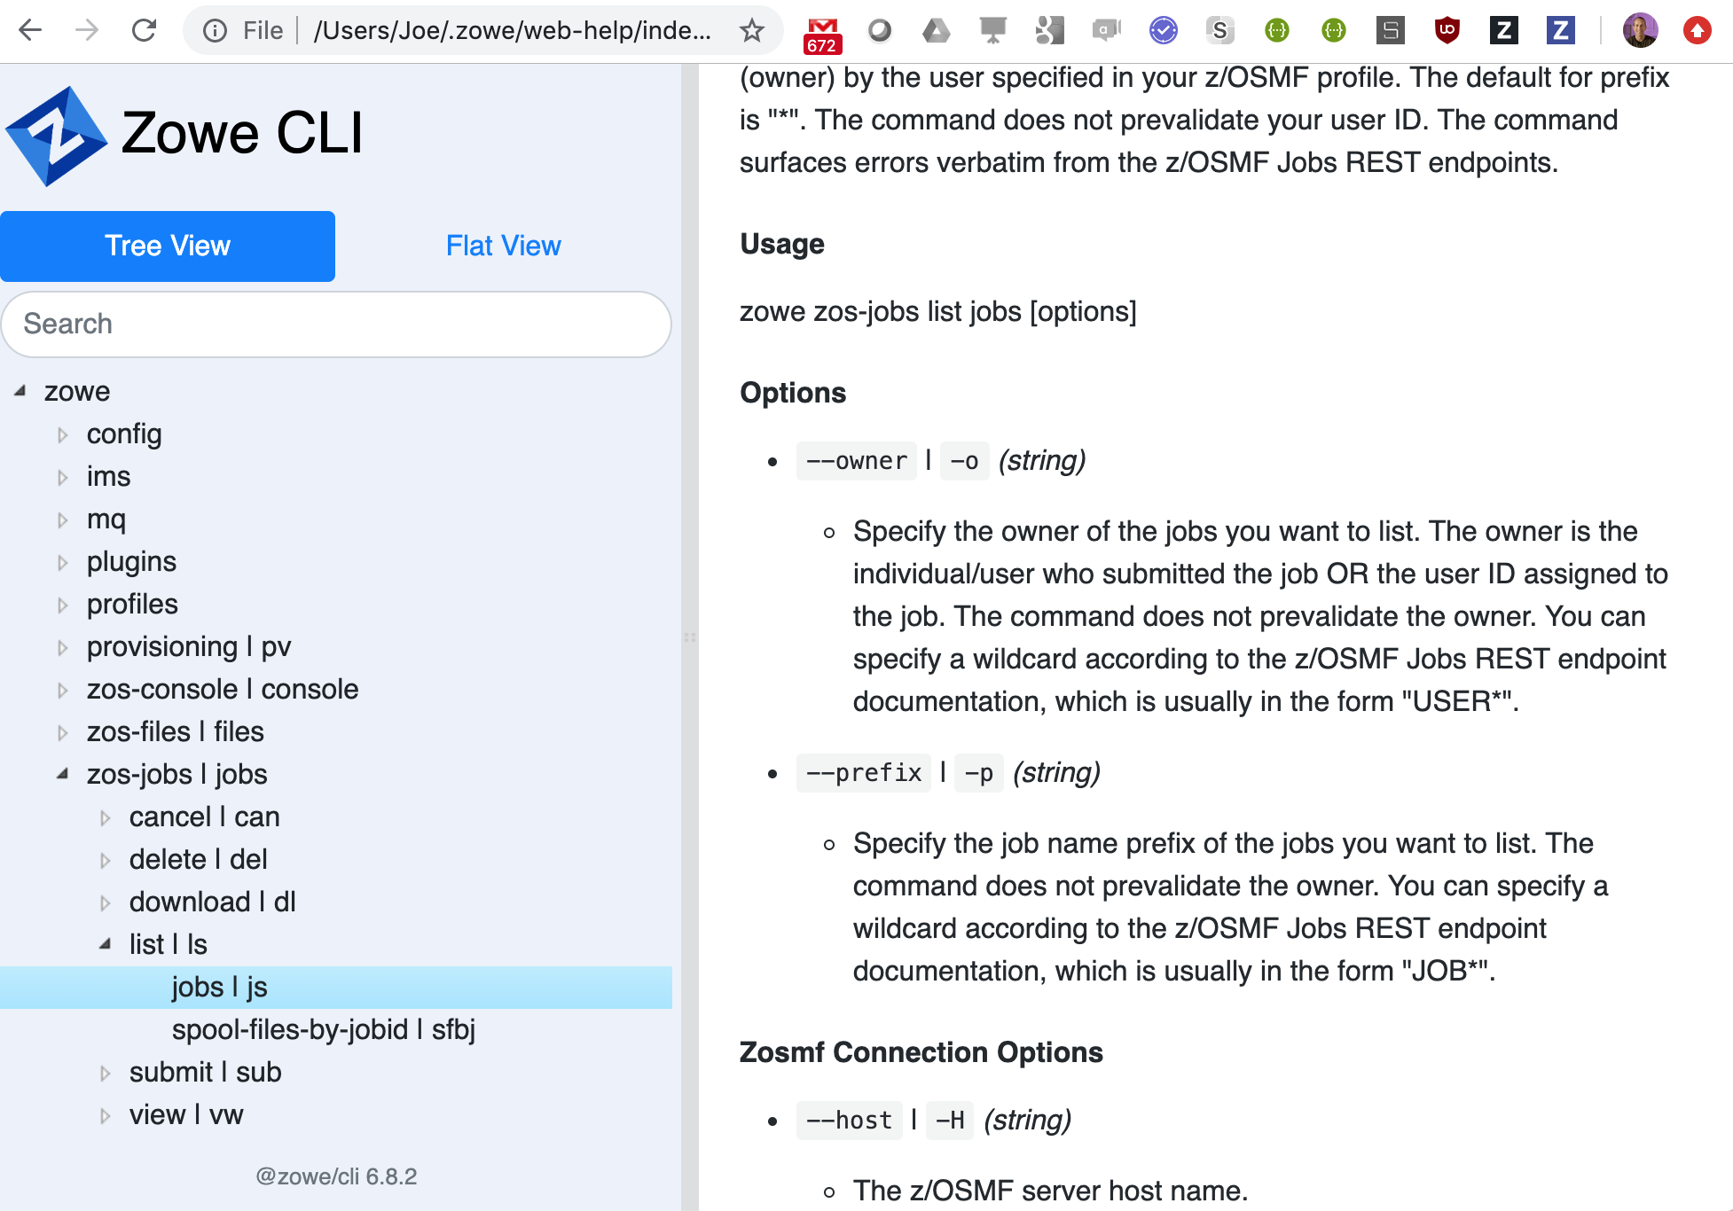
>zowe --hw

Slide 17
DevOps
Continuous Integration Continuous Delivery Pipelines
Automation
Orchestration Scenarios
Secure Encrypted Communication
Laptop’s native credential store
Notes:
Because the CLI is running on the user’s laptop it can be embedded and executed from other tools within the same machine
Such as those for
<click>
DevOps
CICD Pipelines
Automation scripts
And other scenarios where mainframe orchestration is required
This allows a developer familiar with their existing software suite to seamlessly use the Zowe CLI to perform mainframe tasks
<click>
All of this is done with encrypted communication using the laptop’s native credential store

Slide 18
Command Line Interface
Notes:
As well as core capabilities Zowe CLI is built to be an extensible framework allowing additional plugins to be installed, such as those for
<click>
CICS
<click>
DB2 and other mainframe runtimes.
This is done using an extensible API so that

Slide 19
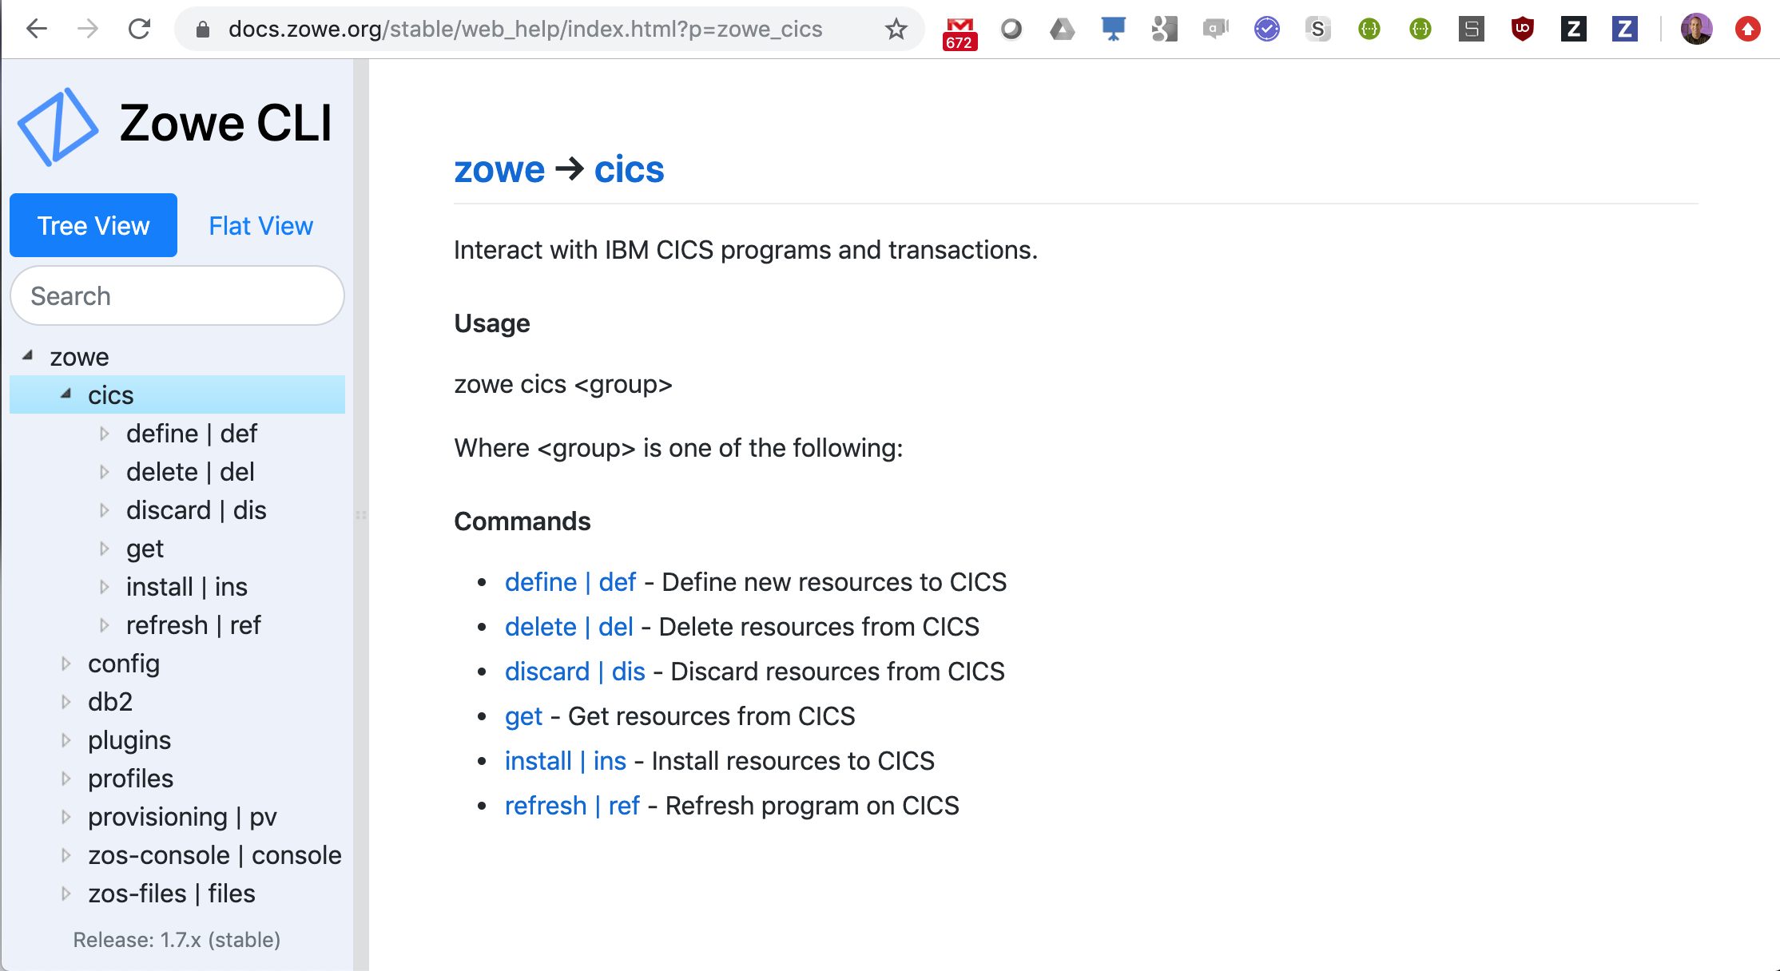

Slide 20
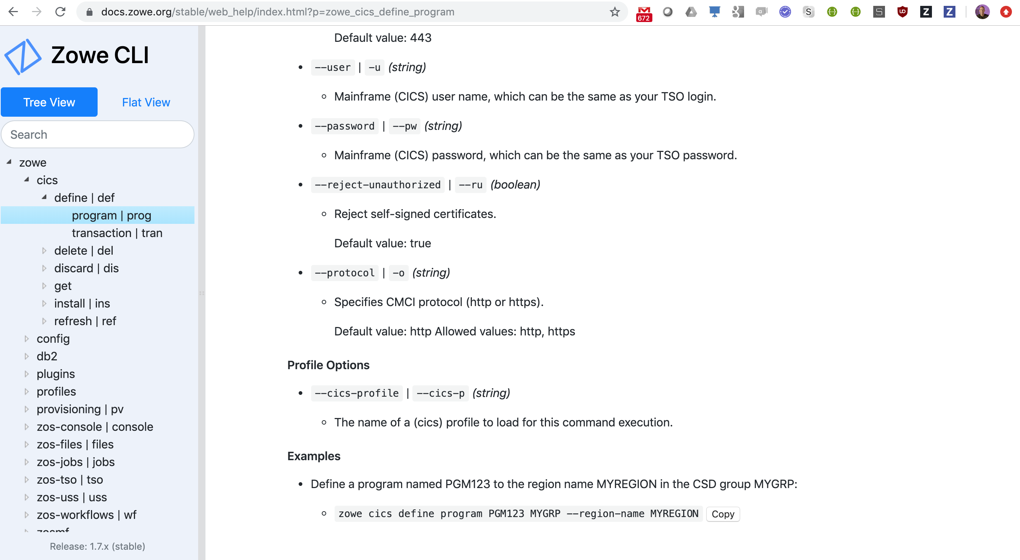
zowe cics define program PGM123 MYGRP --region-name MYREGION

Slide 21
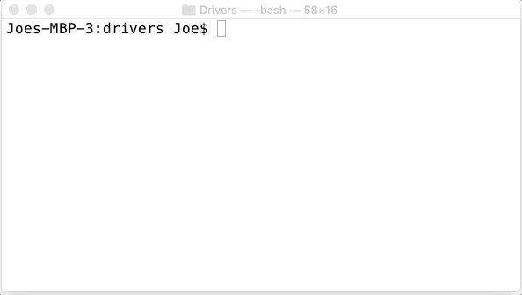

Slide 22

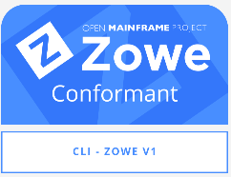
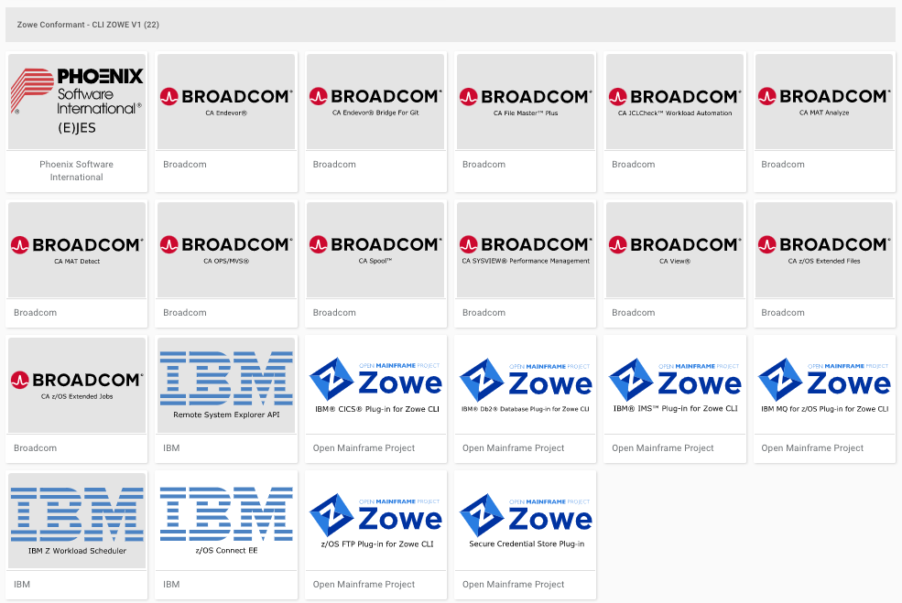
Notes:
Software vendors can built their own CLI plugins using these fully supported interfaces and extension points.
<click>
The Zowe conformance program is a certification process that issues badges to extensions who are built, packaged and execute using these APIs.
This ensures ensuring consistency of end user experience and compatibility between plugins
A number of extensions are available from vendors including
<click>
CA Endeavor, I
<click>
BM z/OS Connect
<click>
Phoenix Software EJES, and more

Slide 24

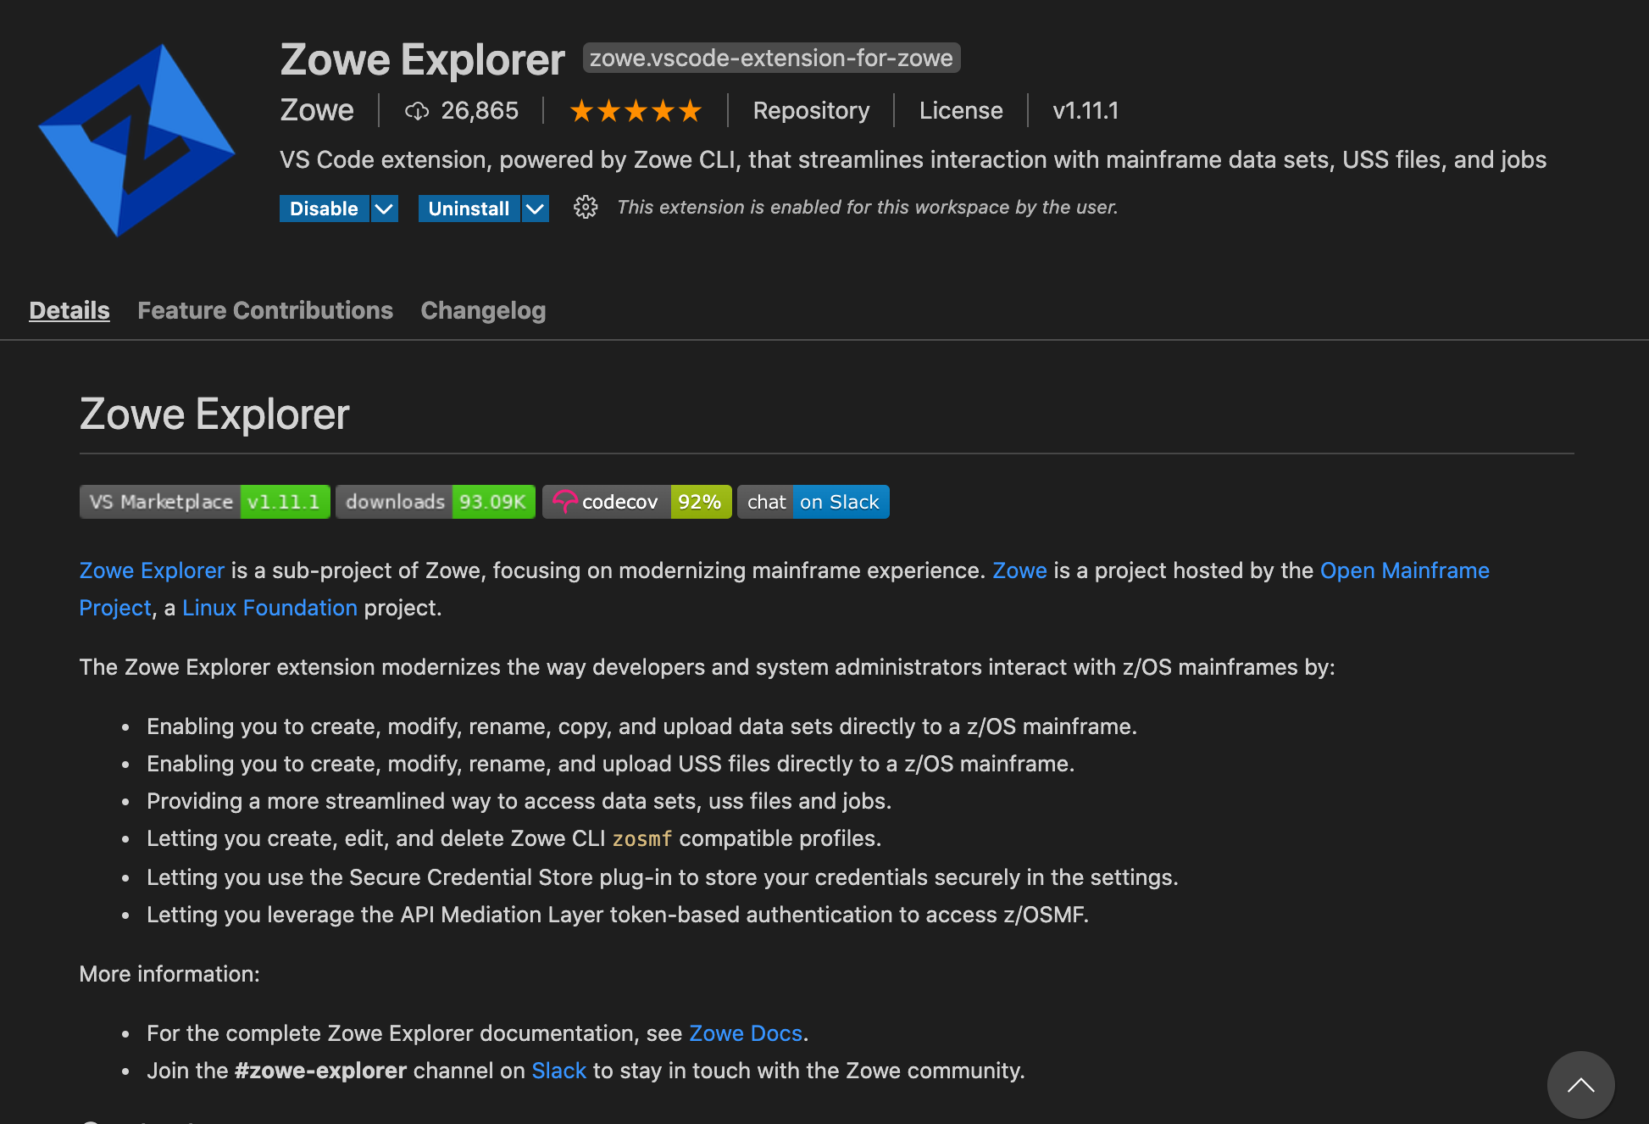
Zowe Explorer
Notes:
The second component to look at is the Zowe Explorer, an extension to the popular Visual Studio Code Integrated Development Environment.
With the Zowe Explorer installed
<click>
it can be launched from the Zowe icon in the VS Code sidebar

Slide 25
Notes:
The Zowe Exolprer has three navigator views for
<click>
Data sets
<click>
Unix System Services
<click>
And Jobs
Let’s take a quick tour of each one

Slide 26
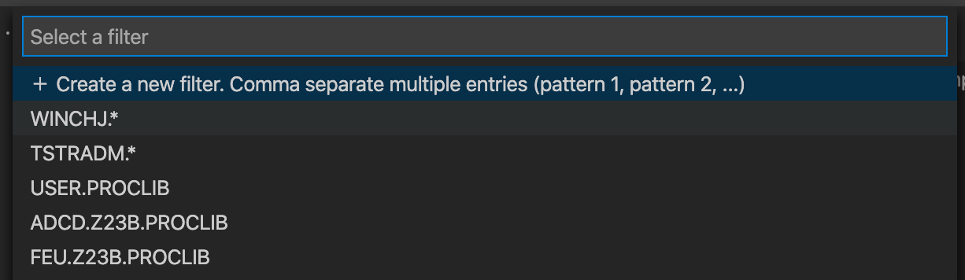
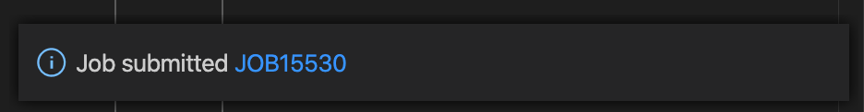
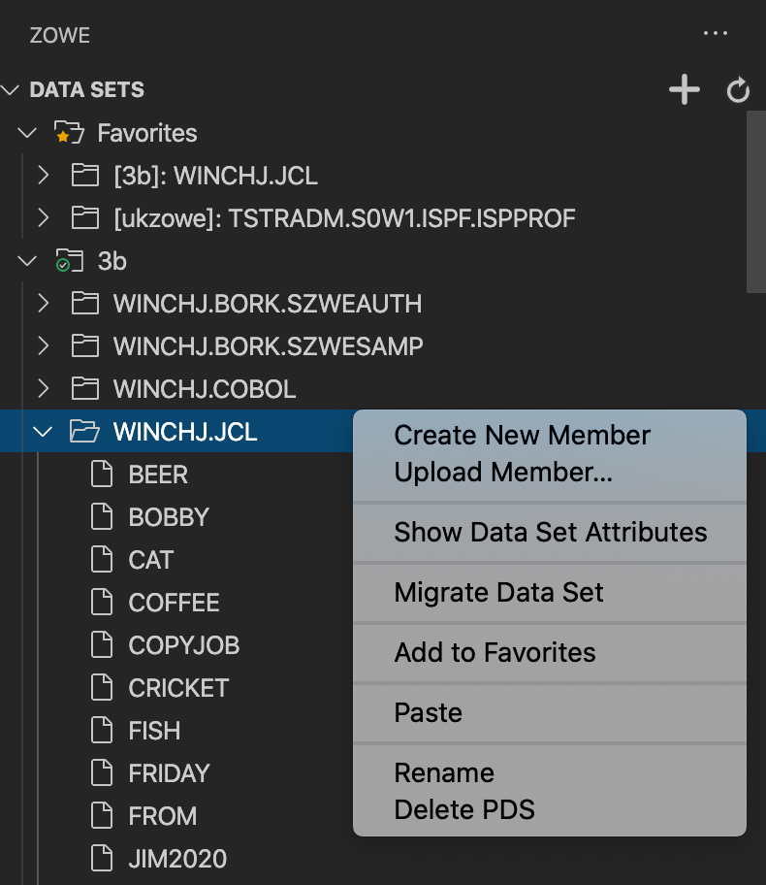
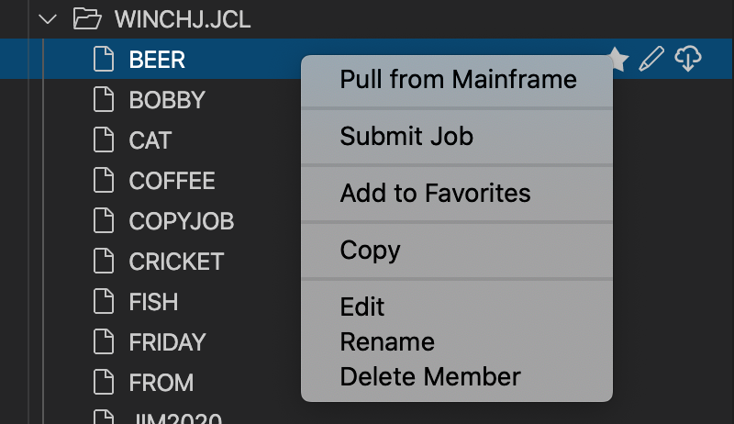
Notes:
<click> The list of data sets can be filtered
<click> showing a tree view of that allows you to expand into the members of a partitioned data set, together with a pop-up menu of actions for create, rename, delete and more.
<click> The menu for a PDS member allows you to
<click> submit submit it as a job
<click> which brings up a hyperlink with the job ID you can select to directly open its spool files.

Slide 27
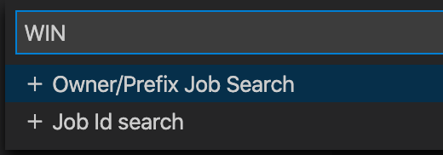
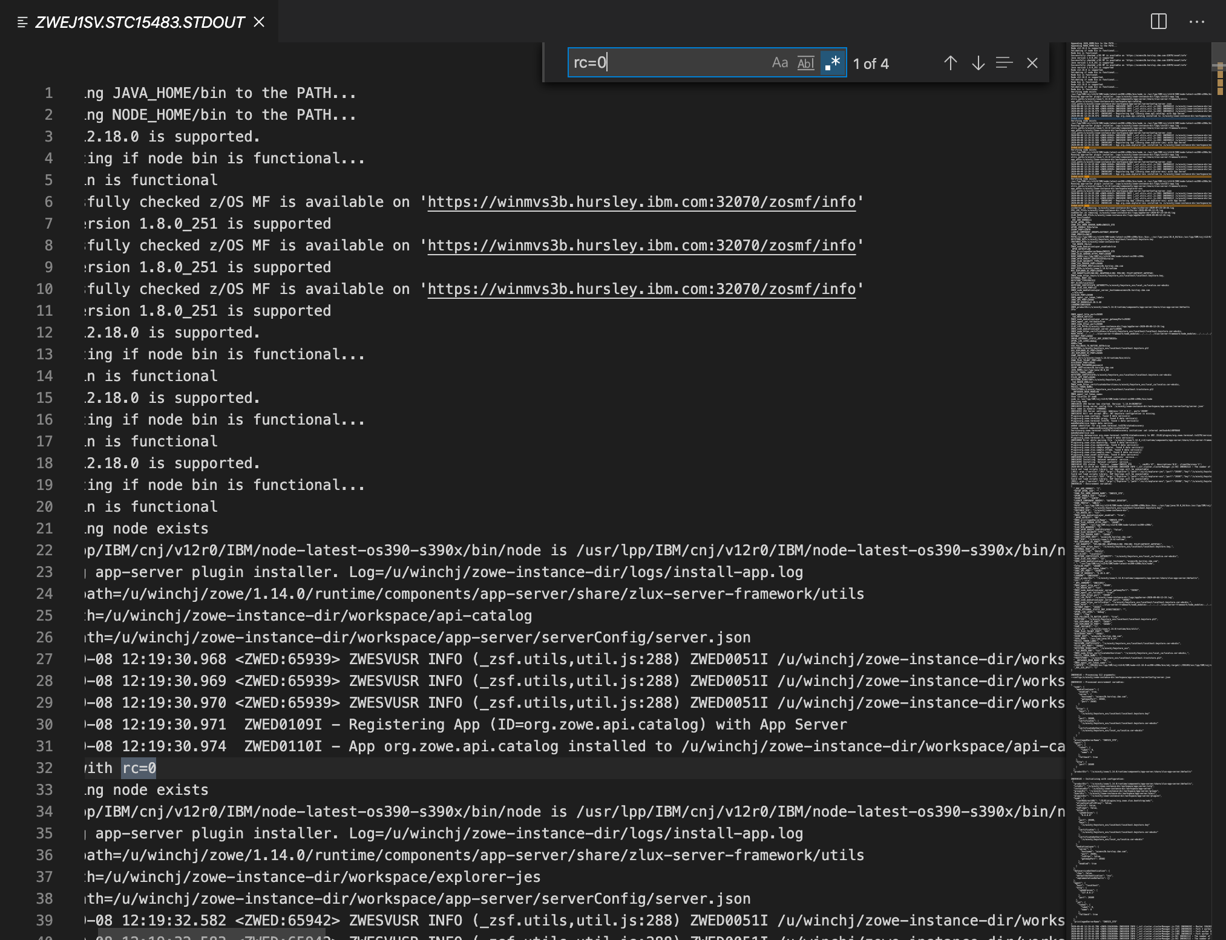
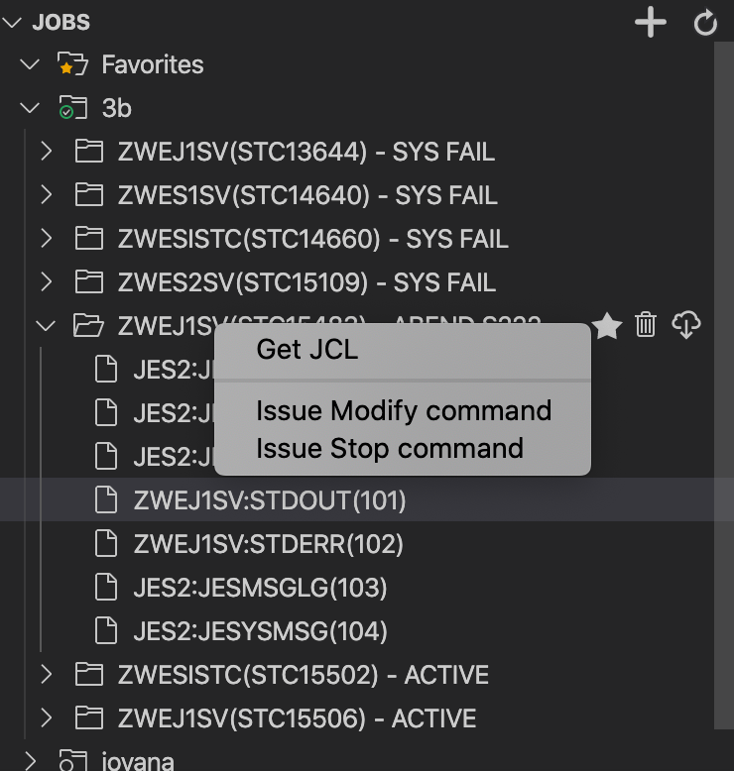
Notes:
<click>
The jobs navigator allows you to filter by Owner and Prefix, or Job ID.
<click>
Jobs can be expanded to see their spool files
<click>
Which are opened in the editor area, allowing you to use VS code features such as searching for strings or navigate the spool file using the overview pane

Slide 28
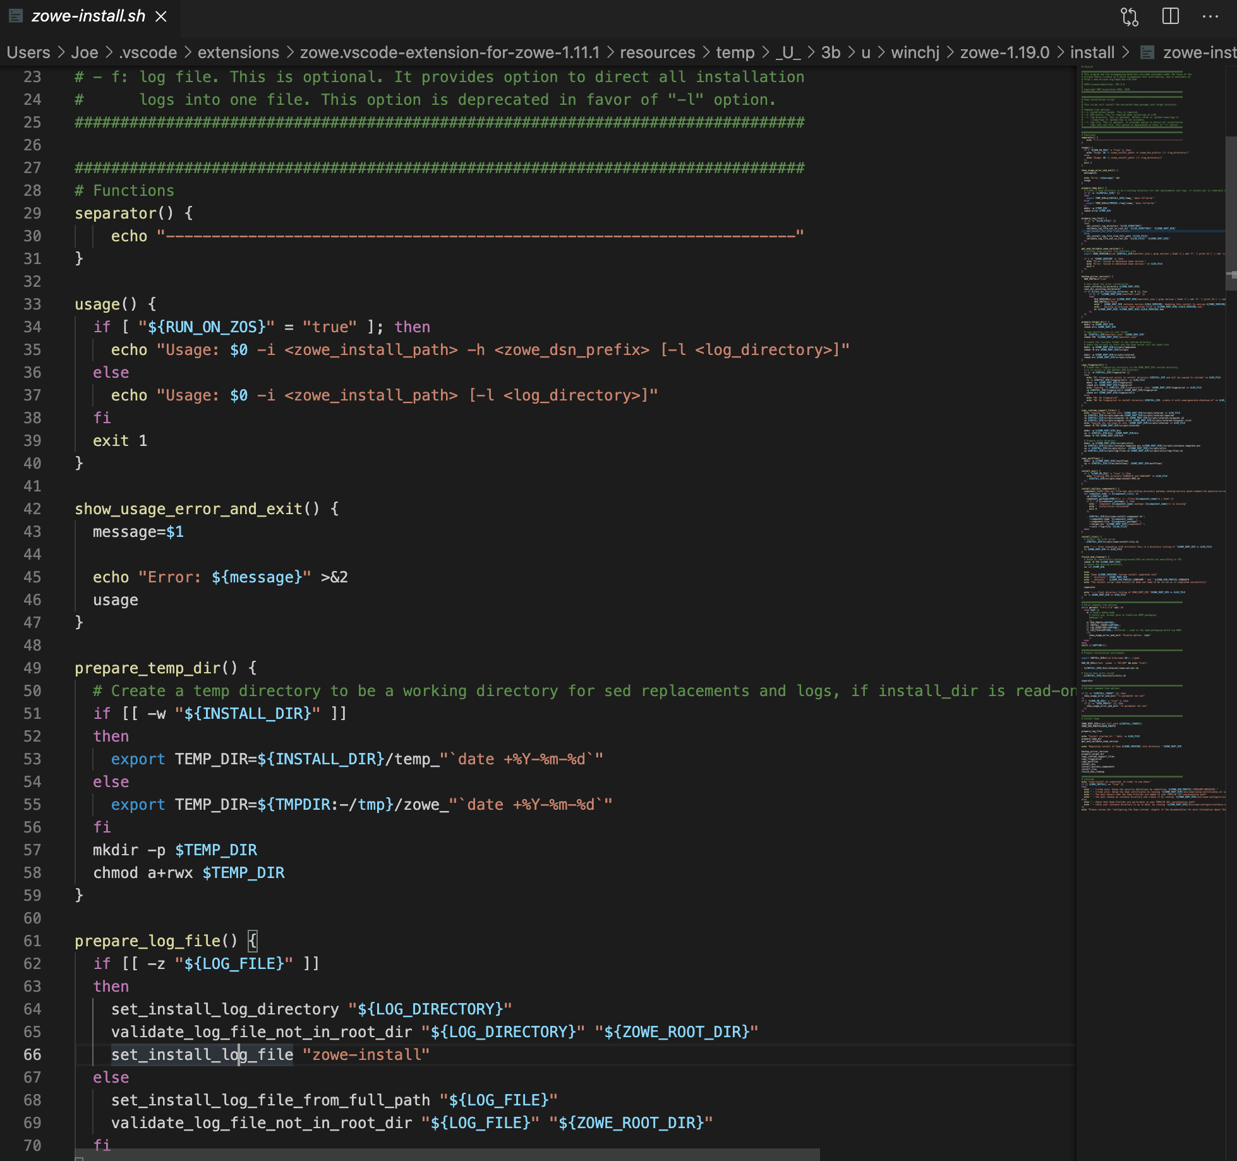
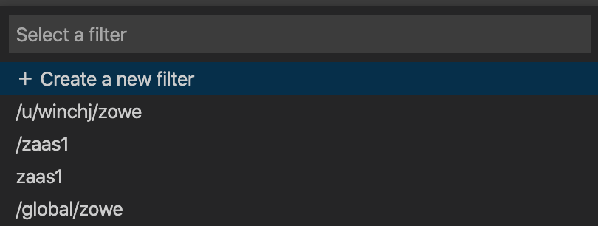
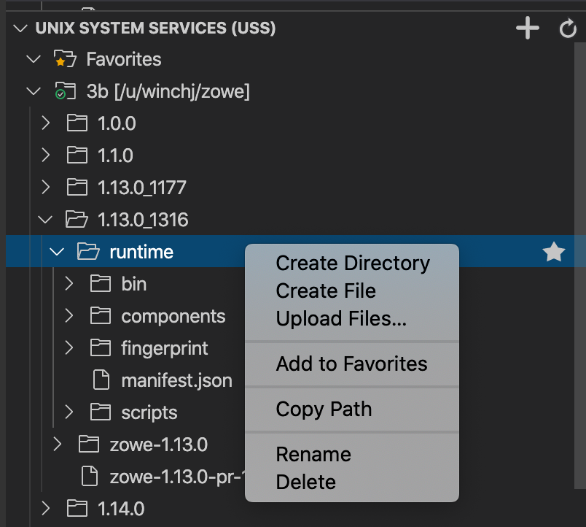
Notes:
<click>
The top level USS directory can be set as a filter
<click>
And the navigator lets you expand into directories showing sub directories and files.
The pop-up menu of actions includes
<click>
The ability to upload files from your PC directly
<click>
As well as open files in the editor area allowing you to make changes that get saved directly back to the mainframe

Slide 29
Mainframe data and JES access from VS Code
Rich language editors
Powerful integrated development environment
Notes:
<click>
The Zowe Explorer is an example of where a user who is already familiar with VS Code is able work with mainframe data directly from within their IDE
<click>
Viewing and editing files alongside other VS code plugins such as rich language editors or debuggers
<click>
Creating a powerful modern extensible tools workbench to enhance mainframe productivity

Slide 30
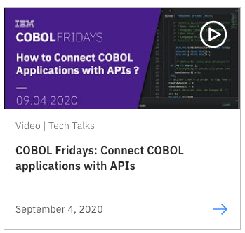
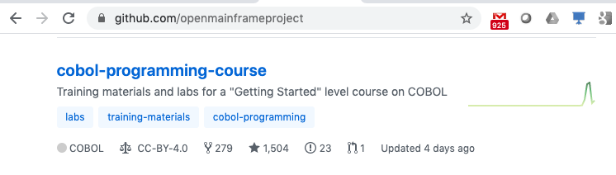
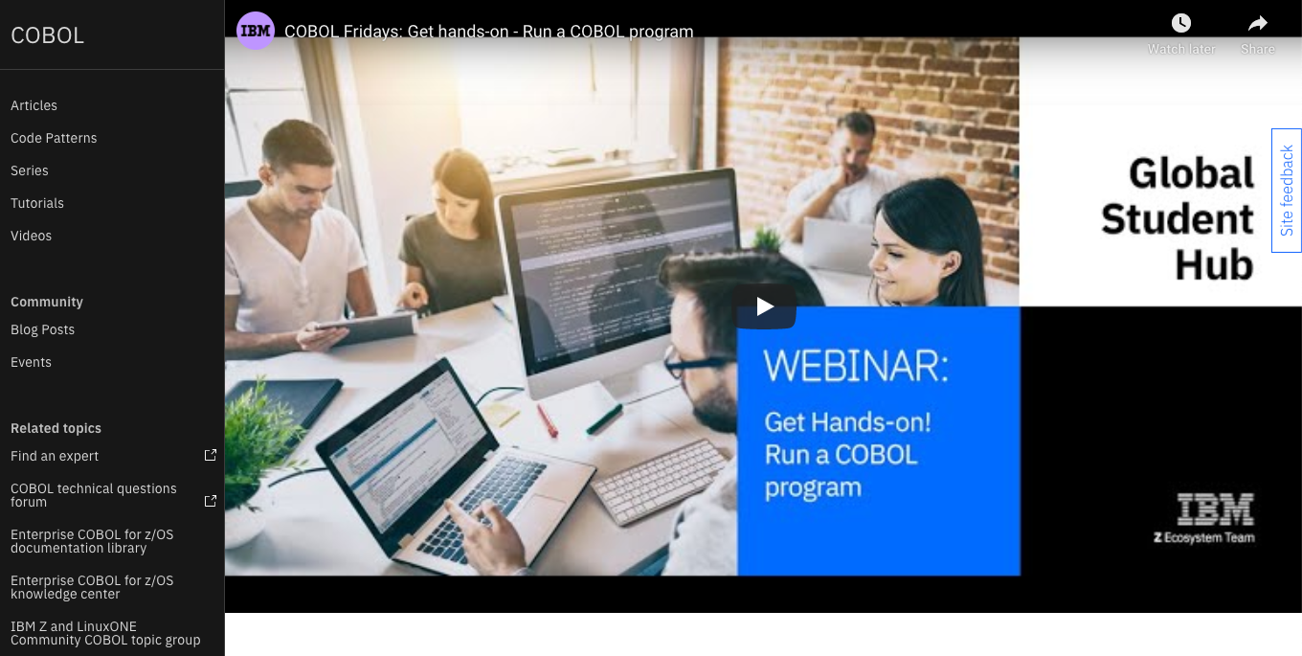
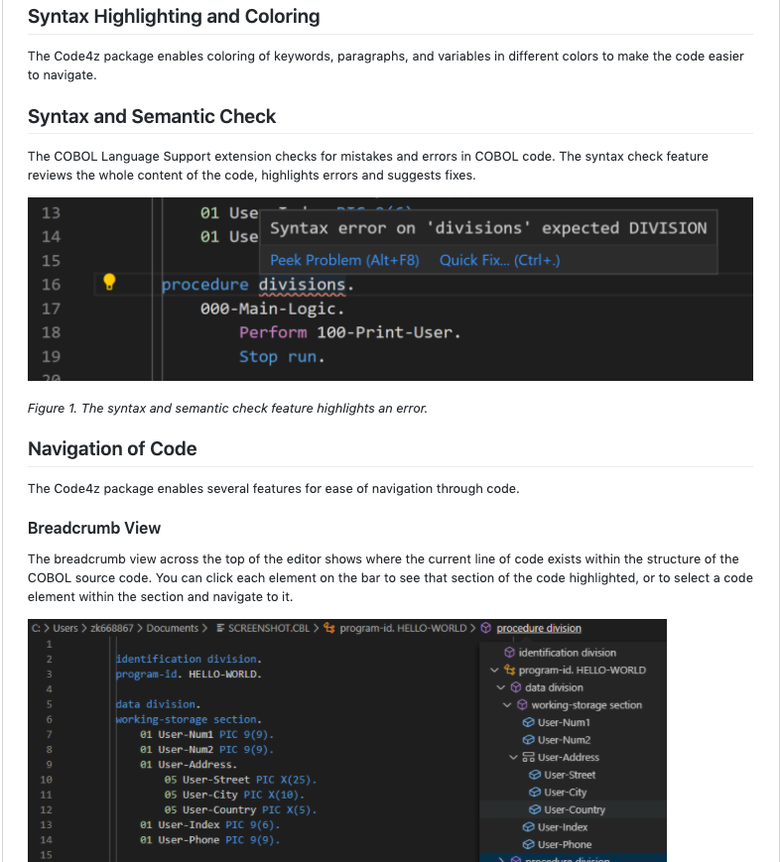
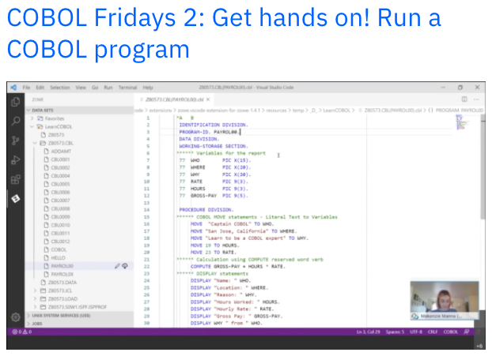

Slide 31
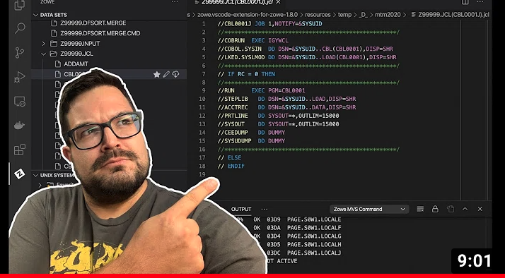


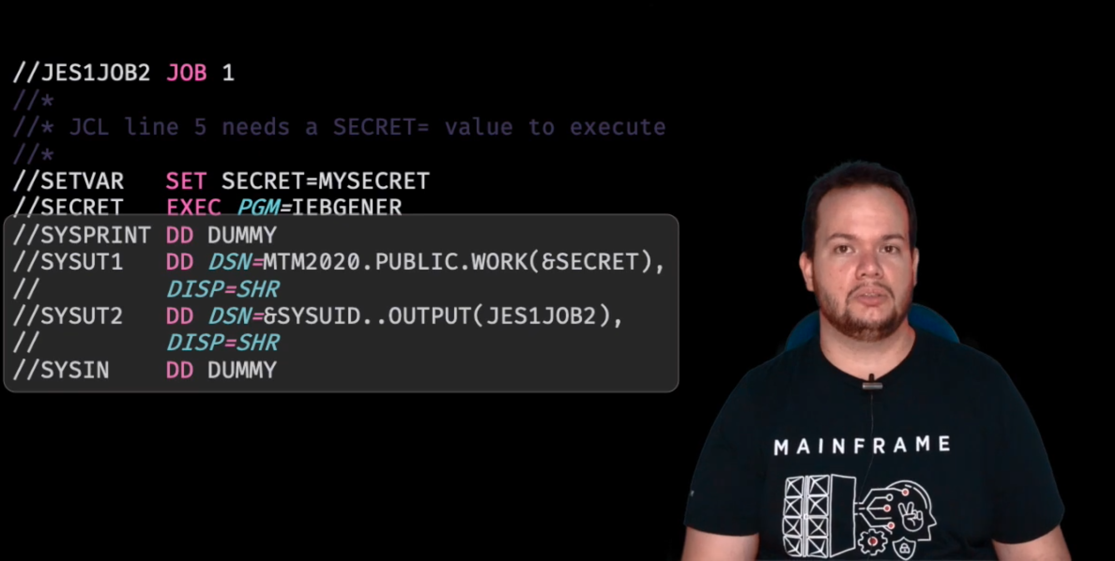
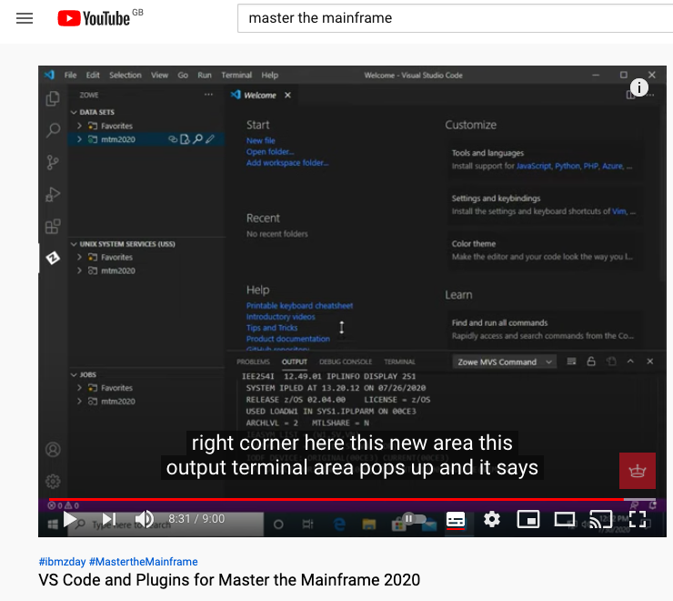
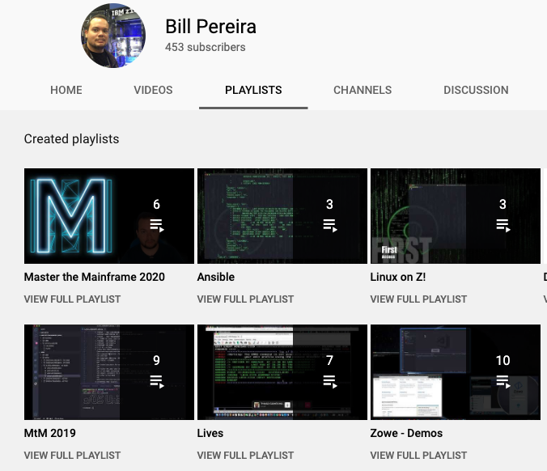

Slide 33
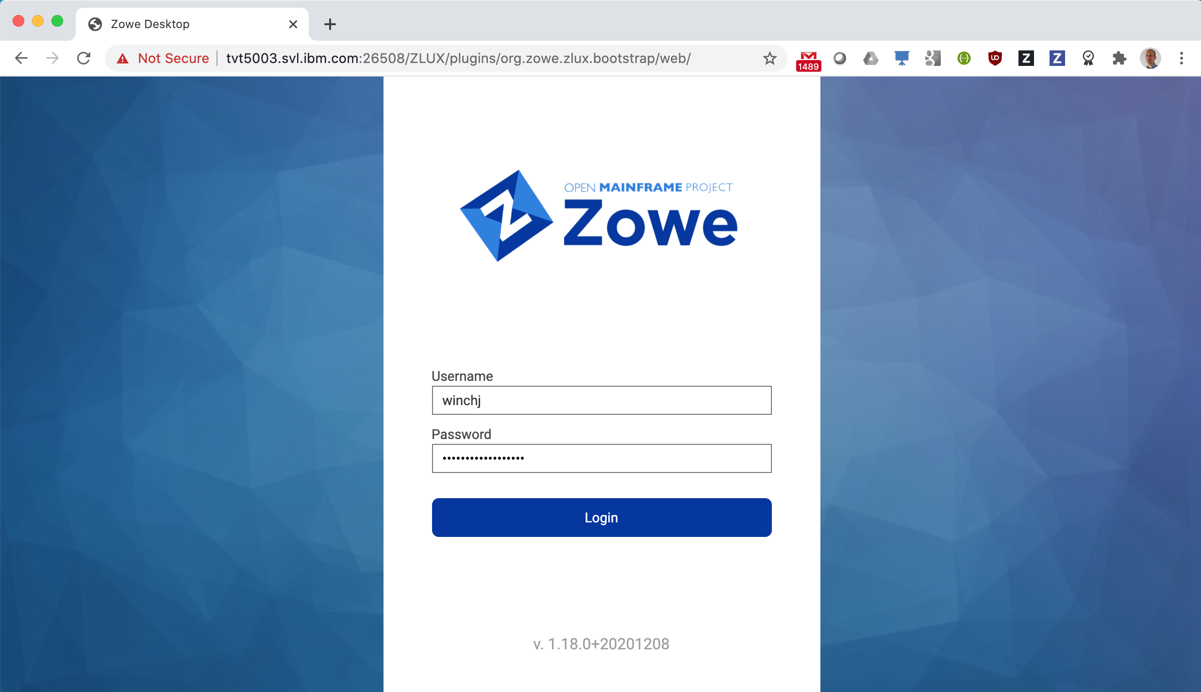
Zowe Desktop
Notes:
The third component to look at is the the Zowe desktop
allows access to mainframe data and services using nothing more than a standard web browser
<click>
Users log into the desktop with their TSO user ID and password.

Slide 34
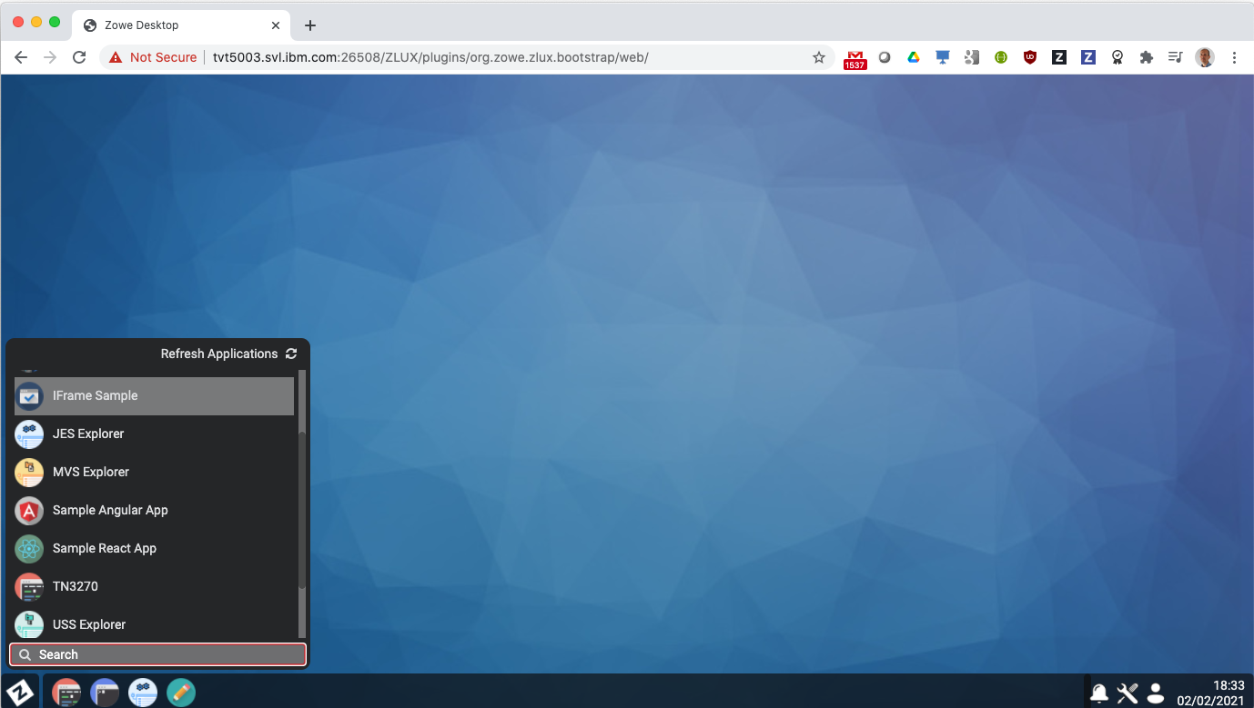
Notes:
Once logged into the Zowe desktop a flyout menu shows a list of the desktop’s available applications.
<click>
Frequently opened ones can be pinned to the bottom task bar, which includes a File Editor

Slide 35
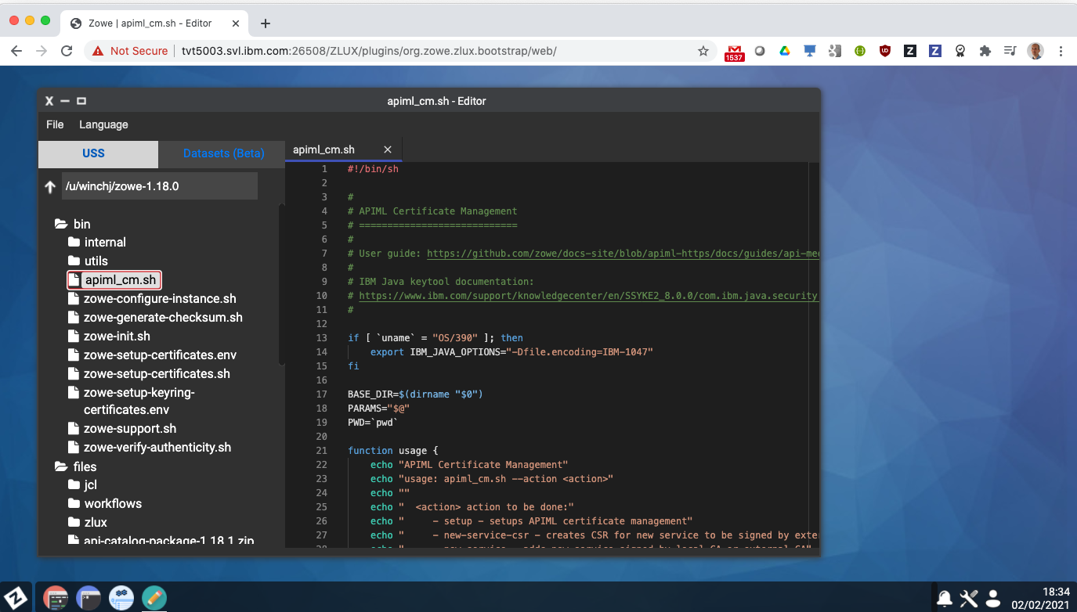
Notes:
The File Editor lets you
<click>
navigate USS directories and files
<click>
together with an editor pane that allows you to view and edit files.
syntax highlighting is provided for a number of files types which auto detects based on file extension
<click>

Slide 36
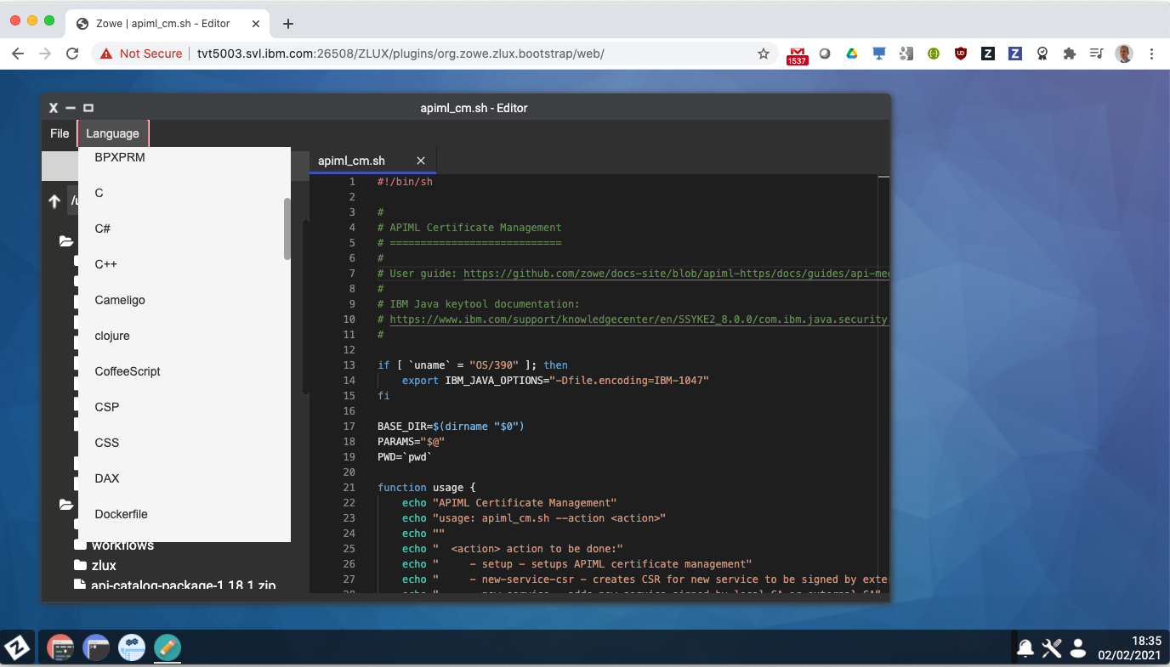
Notes:
but can also be manually selected to choose from a wide range of content types

Slide 37
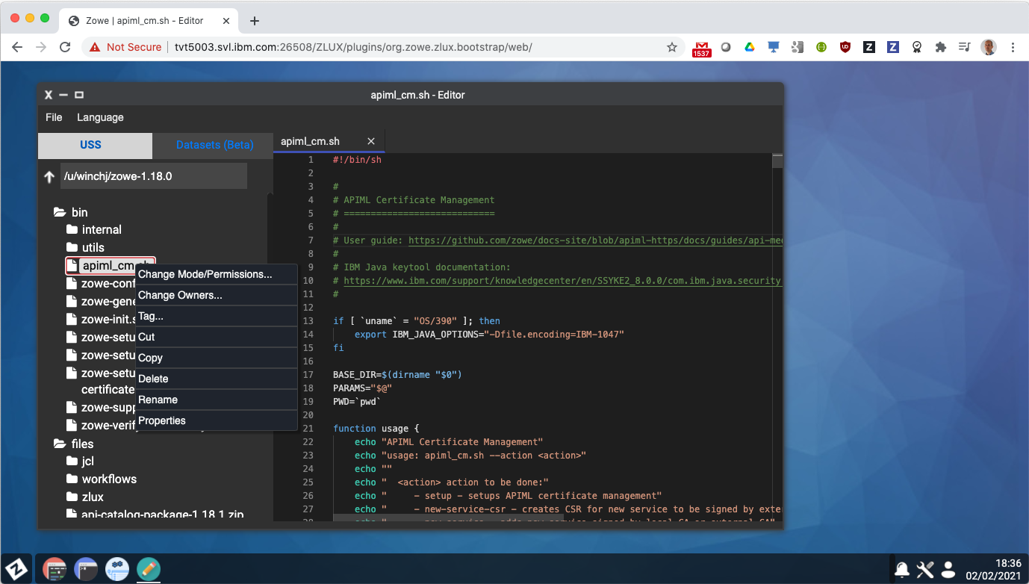
Notes:
The pop-up menu in the navigator tree has actions for , cutcopy and paste, in-place rename,

Slide 38
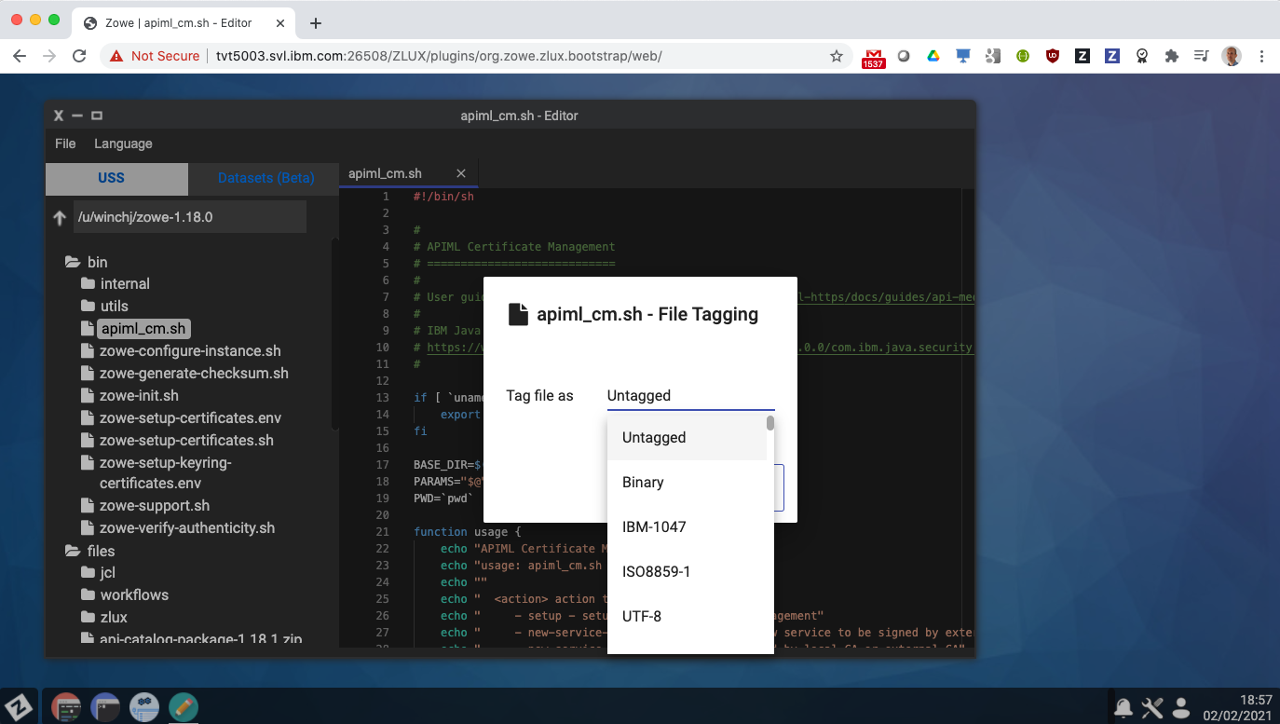
Notes:
The ability to set file tags

Slide 39
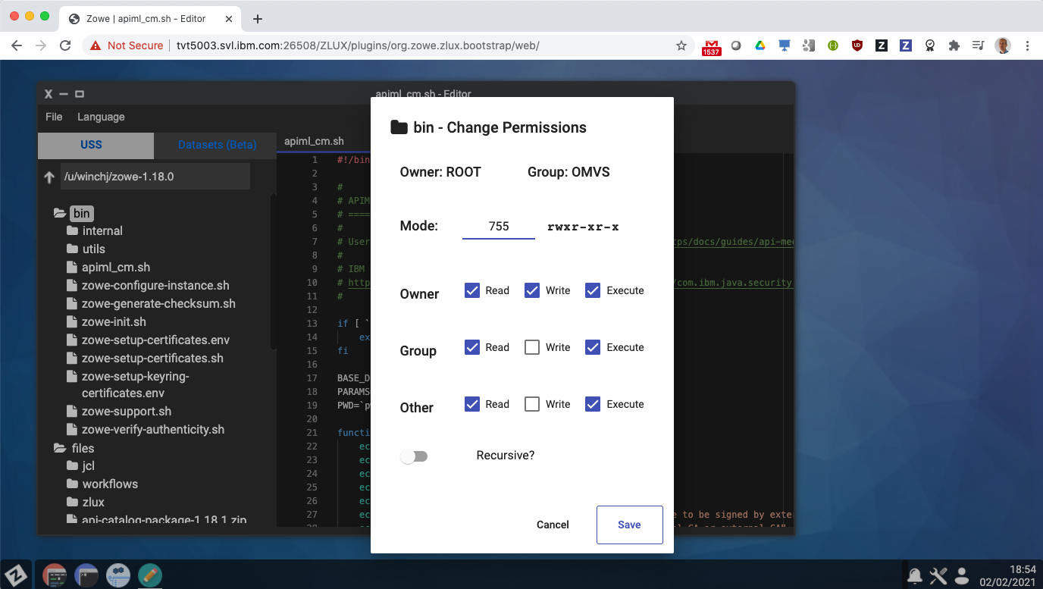
Notes:
As well as change ownership and permissions of files
<click>
and directories which allows recursive updates.
<click>
As well as working with USS the navigator and also work with data sets

Slide 40
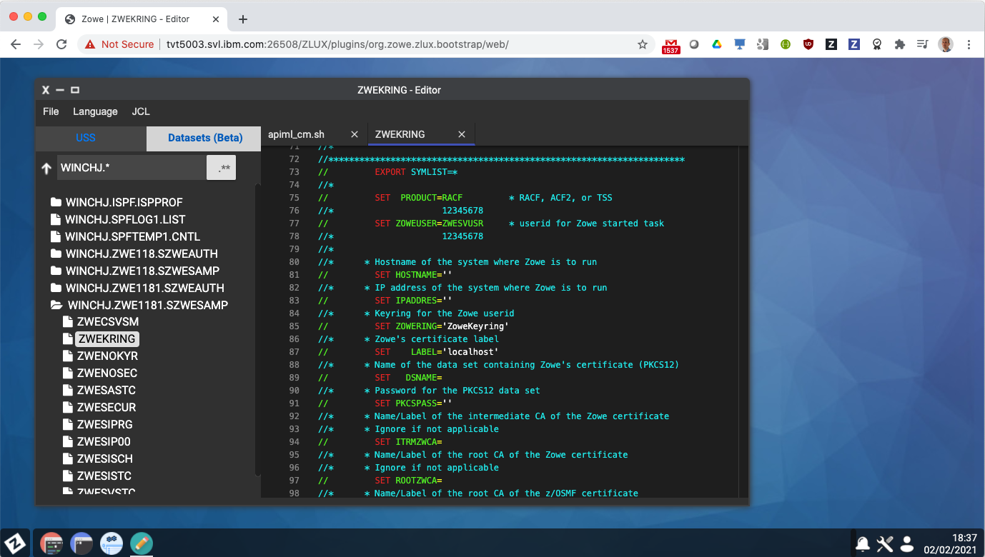
Notes:
<click>
This allows you to filter by high level qualifier to show data sets and their members.
<click>
The file editor includes syntax highlighting for JCL, REXX, assembler and other traditional mainframe languages
<click>
As well as rich GUI apps, the Zowe desktop includes more traditional mainframe interfaces, such as its 3270 emulator

Slide 41

Notes:
From this you can work with TSO, ISPF, SDSF, RACF, and familiar commands.
Zowe deskop apps are opened side by side, allowing you to perform mainframe tasks with your preferred tool of choice.

Slide 42

Notes:
Apps running in the desktop are connected to each other in a number of ways.
They work under the initial logon credentials so the user only has to enter their password once when operating desktop apps, also known as single sign-on which can operate with extended security processes such as multi-factor authentication or client side x509 certificates.
Apps share the same certificate to encrypt data and within the desktop are able to register endpoints to communicate with each other allowing app to app launching

Slide 43

Notes:
App to app launching provides the ability for apps to notify each other, send requests, and interact with desktop services such as persistence
As an example of app to app communication
<click>

Slide 44

Notes:
the JES Explorer app on its own can be used to filter and find jobs to view their spool files and issue commands.
Running in the Zowe desktop it publishes endpoints for its services, which allows the scenario of a user submitting some JCL in the File Editor app, to then have the JES Explorer be opened in the context of the submitted job ID.
App to app communication in the desktop allows the end user experience to be greater than the sum of the parts of each app, providing a smooth transition and hand off of data and context for joined up tasks between desktop plugins

Slide 45

Notes:
The Zowe desktop includes utilities to switch languages,
<click>

Slide 46

Notes:
Which changes the desktop locale locale including all of its apps supporting the new target language

Slide 47


Slide 48
Notes:
Change the logged on user’s TSO password

Slide 49

Notes:
Which helps with management of credentials

Slide 50
Notes:
as well as personalization which provides the ability

Slide 51

Notes:
To change the color theme and icon sizes for the desktop

Slide 52

Notes:
Together with the ability to set a custom desktop

Slide 53

Notes:
Zowe desktop apps aren’t restricted to run as tiles, and can be opened in a new browser tab

Slide 54

Notes:
When they can be used like any other web page in the browser, with a URL that can be bookmarked and used to navigate to the
A good use of this is for mainframers who are comfortable with 3270 interfaces, who can launch the emulator in a browser tab and access their mainframe without the need for any host emulation software on their laptop.

Slide 55
Modern GUIs
Traditional Interfaces
Side by side in a web browser
Single sign-on
App to app launching
All of the old with all of the new
Notes:
The Zowe desktop provides is a way for end users to acces their mainframe data using
<click>
Modern guis
<click>
As well as traditional interfaces
<click>
side by side in a web browser, under the user’s initial TSO logon credentials
<click>
Zowe desktop apps operated with single sign-on which supports multi-factor authentication for just a single initial password challenge at first logon.
<click>
Apps communicate and interact with each other through in context launching and awareness.
<click>
The Zowe desktop fulfills one of Zowe’s initial goals, is to provide all of the old with all of the new, so end users can choose to work with whichever app makes them productive for their given task, their given skill set, their given experience and background

Slide 56




Notes:
A good way to think of the Zowe desktop and its apps is like a mobile phone.
Both come with a great set of base apps, but also have the ability to extend through additional marketplace extensions
Zowe desktop extension plugins can be provided by software vendors or even customers themselves and the Zowe extender documentation provides open source samples of how to do this together with extensive SDK documentation.
<click>
Software vendors can apply for a Zowe conformance badge to demonstrate their plugin is built to a set of defined APIs for interoperability and end user consistency.
<click>
Examples of this are Rocket BlueZone web,
<click>
And Segus Engineering SQL Workload Expert for DB2 z/OS.

Slide 57
Notes:
The Zowe desktop provides is a way for end users to acces their mainframe data using
<click>
Modern guis
<click>
As well as traditional interfaces
<click>
side by side in a web browser, under the user’s initial TSO logon credentials
<click>
Zowe desktop apps operated with single sign-on which supports multi-factor authentication for just a single initial password challenge at first logon.
<click>
Apps communicate and interact with each other through in context launching and awareness.
<click>
The Zowe desktop fulfills one of Zowe’s initial goals, is to provide all of the old with all of the new, so end users can choose to work with whichever app makes them productive for their given task, their given skill set, their given experience and background

Slide 58
API Routing – Reverse Proxy Edge Server - Netflix Zuul
Single sign-on (SSO), Multi Factor Authentication (MFA),
x509 client cert auth
API Catalog – Swagger / Open Api
API Balancing – Workload Management of requests
Single Certificate and external IP
High Availability
Notes:
The Zowe desktop provides is a way for end users to acces their mainframe data using
<click>
Modern guis
<click>
As well as traditional interfaces
<click>
side by side in a web browser, under the user’s initial TSO logon credentials
<click>
Zowe desktop apps operated with single sign-on which supports multi-factor authentication for just a single initial password challenge at first logon.
<click>
Apps communicate and interact with each other through in context launching and awareness.
<click>
The Zowe desktop fulfills one of Zowe’s initial goals, is to provide all of the old with all of the new, so end users can choose to work with whichever app makes them productive for their given task, their given skill set, their given experience and background

Slide 59







Zowe
Explorer
VS Code
Core desktop apps
Extension Plugins
Extension
Plugins
Core CLI
Core Extensions
File Editor
3270 Terminal
MVS Explorer
JES Explorer
USS Explorer
iFrame
HTML
CLI
extension
IMS
CICS
DB2
MQ
Zowe Desktop running in web browser
Zowe CLI running in desktop shell
7554
API Gateway
(optional needed for SSO/MFA)
8544
7552
7553
Telnet
ZLUX
23
API Catalog
API Discovery
3270
Apps…
8548
8546
8550
VT Terminal
File Editor
Included as apps
MVS UI
JES UI
USS
UI
SSH
22
node
8542
8547
8545
zssServer
/S ZWESVSTC
File API
JES API
nnnn
7443
REST API Extension Server
z/OSMF
IMS Ops
API
CICS CMCI
DB2
MQ Console
REST APIs
Workflows
TSO / MVS Commands
Files, USS, JES
SSO token generation
X-MEM
Java
ZWESIS01
/S ZWESISTC
Node.js
IMS Connect
metal C / C
Notes:
If you update this diagram, please update “zowe-desktop-unable-to-logon.pptx” and PNG file as well.

Slide 60
Zowe
Explorer
VS Code
Core desktop apps
Extension Plugins
Extension
Plugins
Core CLI
Core Extensions
File Editor
3270 Terminal
MVS Explorer
JES Explorer
USS Explorer
iFrame
HTML
CLI
extension
IMS
CICS
DB2
MQ
Zowe Desktop running in web browser
Zowe CLI running in desktop shell
7554
API Gateway
(optional needed for SSO/MFA)
8544
7552
7553
Telnet
ZLUX
23
API Catalog
API Discovery
3270
Apps…
8548
8546
8550
VT Terminal
File Editor
Included as apps
MVS UI
JES UI
USS
UI
SSH
22
node
8542
8547
8545
zssServer
/S ZWESVSTC
File API
JES API
nnnn
7443
REST API Extension Server
z/OSMF
IMS Ops
API
CICS CMCI
DB2
MQ Console
REST APIs
Workflows
TSO / MVS Commands
Files, USS, JES
SSO token generation
X-MEM
Java
ZWESIS01
/S ZWESISTC
Node.js
IMS Connect
metal C / C

Slide 61

Notes:
<click>
Because all of these commands are running on my laptop where I showed them operating from my MacBook’s terminal, it opens up the apeteure where I can run the commands from any other tool on my laptop that can issue commands such as those for
<click>
DevOps tooling
<click>
CICD pipelines such as a Jenkins server, Travis, Team City, or other enterprise rel eng tools
<click>
Automation scripts
<click>
And other scenarios where mainframe orchestration if required
This allows a developer familiar with their existing software suite to seamlessly use the Zowe CLI to bring the mainframe into their world of tooling, making it a more familiar computing platform
All of this is done with encrypted communication using the laptop’s native credential store

Slide 62


Slide 63


Slide 64


Slide 65


Slide 66
Zowe
Explorer
VS Code
Core desktop apps
Extension Plugins
Extension
Plugins
Core CLI
Core Extensions
File Editor
3270 Terminal
MVS Explorer
JES Explorer
USS Explorer
iFrame
HTML
CLI
extension
IMS
CICS
DB2
MQ
Zowe Desktop running in web browser
Zowe CLI running in desktop shell
One time password
Client to gateway
7554
API Gateway
(optional needed for SSO/MFA)
8544
7552
7553
Telnet
ZLUX
23
API Catalog
API Discovery
Passticket
3270
Apps…
8548
8546
8550
VT Terminal
File Editor
Included as apps
MVS UI
JES UI
USS
UI
Gateway to
service
SSH
22
node
8542
8547
8545
zssServer
/S ZWESVSTC
File API
JES API
nnnn
7443
REST API Extension Server
z/OSMF
IMS Ops
API
CICS CMCI
DB2
MQ Console
REST APIs
Workflows
TSO / MVS Commands
Files, USS, JES
SSO token generation
X-MEM
Java
ZWESIS01
/S ZWESISTC
Node.js
IMS Connect
metal C / C
IMS Connect
CICS CMCI

Slide 67

Zowe
Explorer
VS Code
Core desktop apps
Extension Plugins
Extension
Plugins
Core CLI
Core Extensions
File Editor
3270 Terminal
MVS Explorer
JES Explorer
USS Explorer
iFrame
HTML
CLI
extension
IMS
CICS
DB2
MQ
Zowe Desktop running in web browser
Zowe CLI running in desktop shell
7554
API Gateway
(optional needed for SSO/MFA)
8544
7552
7553
Telnet
ZLUX
23
API Catalog
API Discovery
3270
Apps…
8548
8546
8550
VT Terminal
File Editor
Included as apps
MVS UI
JES UI
USS
UI
SSH
22
node
8547
8545
/S ZWESVSTC
File API
JES API
8542
nnnn
7443
REST API Extension Server
z/OSMF
IMS Ops
API
CICS CMCI
DB2
MQ Console
zssServer
REST APIs
Workflows
TSO / MVS Commands
Files, USS, JES
SSO token generation
X-MEM
Java
ZWESIS01
/S ZWESISTC
Node.js
IMS Connect
metal C / C
Notes:
If you update this diagram, please update “zowe-desktop-unable-to-logon.pptx” and PNG file as well.

Slide 68
Notes:
technical blogs

Slide 69



Notes:
technical blogs

Slide 70



Notes:
technical blogs

Slide 71










Slide 72
We are building more than technology
We are building a community
Notes:
Its goal is to provide a platform for access to the mainframe using tools that are
<click to animate text>
Open
Simple
Familiar
<click to introduce red border around zowe.org graphic>
Information about Zowe can be found at zowe.org

Slide 73
Notes:
technical blogs

